Slide 1
Processes Description and Control
Notes:
“Operating Systems: Internal and Design Principles”, 7/e, by William Stallings, Chapter 3 “Process Description and Control”.

Slide 2
Operating Systems: Internals and Design Principles
The concept of process is fundamental to the structure of modern computer operating systems.
Most requirements that an OS must meet can be expressed with reference to processes:
OS must interleave the execution of multiple processes, to maximize processor utilization while providing reasonable response time
OS must allocate resources to processes in conformance to a specific policy (e.g.) while at the same time avoid deadlocks
OS maybe required to support inter-process-communication and user creation of processes, both of which may aid in the structuring of applications.
Its evolution in analyzing problems of synchronization, deadlock, and scheduling in operating systems has been a major intellectual contribution of computer science.
Notes:
All multiprogramming operating systems, from single-user systems such as Windows
for end users to mainframe systems such as IBM’s mainframe operating system,
z/OS, which can support thousands of users, are built around the concept of the
process. Most requirements that the OS must meet can be expressed with reference
to processes:
• The OS must interleave the execution of multiple processes, to maximize processor
utilization while providing reasonable response time.
• The OS must allocate resources to processes in conformance with a specific
policy (e.g., certain functions or applications are of higher priority) while at
the same time avoiding deadlock.
• The OS may be required to support interprocess communication and user creation
of processes, both of which may aid in the structuring of applications.
We begin with an examination of the way in which the OS represents and
controls processes. Then, the chapter discusses process states, which characterize
the behavior of processes. Then we look at the data structures that the OS uses to
manage processes. These include data structures to represent the state of each
process and data structures that record other characteristics of processes that the
OS needs to achieve its objectives. Next, we look at the ways in which the OS uses
these data structures to control process execution. Finally, we discuss process
management in UNIX SVR4. Chapter 4 provides more modern examples of
process management.
This chapter occasionally refers to virtual memory. Much of the time, we can
ignore this concept in dealing with processes, but at certain points in the discussion,
virtual memory considerations are pertinent. Virtual memory is previewed in
Chapter 2 and discussed in detail in Chapter 8 . A set of animations that illustrate
concepts in this chapter is available online. Click on the rotating globe at this book’s
Web site at WilliamStallings.com/OS/OS7e.html for access.

Slide 3
Summary of Earlier Concepts
A computer platform consists of a collection of hardware resources
Computer applications are developed to perform some task
It is inefficient for applications to be written directly for a given hardware platform
The OS was developed to provide a convenient, feature-rich, secure, and consistent interface for applications to use
We can think of the OS as providing a uniform, abstract representation of resources that can be requested and accessed by applications
Notes:
Before defining the term process , it is useful to summarize some of the concepts
introduced in Chapters 1 and 2 :
1. A computer platform consists of a collection of hardware resources, such as
the processor, main memory, I/O modules, timers, disk drives, and so on.
2. Computer applications are developed to perform some task. Typically, they
accept input from the outside world, perform some processing, and generate
output.
3. It is inefficient for applications to be written directly for a given hardware
platform. The principal reasons for this are as follows:
a. Numerous applications can be developed for the same platform. Thus, it
makes sense to develop common routines for accessing the computer’s
resources.
b. The processor itself provides only limited support for multiprogramming.
Software is needed to manage the sharing of the processor and other
resources by multiple applications at the same time.
c. When multiple applications are active at the same time, it is necessary to
protect the data, I/O use, and other resource use of each application from
the others.
4. The OS was developed to provide a convenient, feature-rich, secure, and consistent
interface for applications to use. The OS is a layer of software between
the applications and the computer hardware ( Figure 2.1 ) that supports applications
and utilities.
5. We can think of the OS as providing a uniform, abstract representation of
resources that can be requested and accessed by applications. Resources
include main memory, network interfaces, file systems, and so on. Once the
OS has created these resource abstractions for applications to use, it must
also manage their use. For example, an OS may permit resource sharing and
resource protection.

Slide 4
OS Management of Application Execution
Resources are made available to multiple applications
The processor is switched among multiple applications so all will appear to be progressing
The processor and I/O devices can be used efficiently
Notes:
Now that we have the concepts of applications, system software, and resources,
we are in a position to discuss how the OS can, in an orderly fashion, manage the
execution of applications so that
• Resources are made available to multiple applications.
• The physical processor is switched among multiple applications so all will
appear to be progressing.
• The processor and I/O devices can be used efficiently.
The approach taken by all modern operating systems is to rely on a model in
which the execution of an application corresponds to the existence of one or more
processes.

Slide 5
Process Concept
Process – a program in execution; process execution must progress in sequential fashion
Program is passive entity stored on disk (executable file), process is active
Program becomes process when executable file loaded into memory
Execution of program started via:
GUI mouse clicks,
command line entry of its name,
etc
One program can be several processes
Consider multiple users executing the same program

Slide 6
Process Elements
Two essential elements of a process are:
When the processor begins to execute the program code, we refer to this executing entity as a process
Program code
which may be shared with other processes that are executing the same program
A set of data associated with that code
Notes:
Recall from Chapter 2 that we suggested several definitions of the term process ,
including
• A program in execution
• An instance of a program running on a computer
• The entity that can be assigned to and executed on a processor
• A unit of activity characterized by the execution of a sequence of instructions,
a current state, and an associated set of system resources
We can also think of a process as an entity that consists of a number of elements.
Two essential elements of a process are program code (which may be shared with
other processes that are executing the same program) and a set of data associated
with that code. Let us suppose that the processor begins to execute this program
code, and we refer to this executing entity as a process.

Slide 7
Process Structure
A process is more than the program code, which is sometimes known as the text section.
It also includes the current activity:
The value of the program counter
The contents of the processor's registers.
It also includes the process stack, which contains temporary data (such as function parameters, return addresses, and local variables)
It also includes the data section, which contains global variables.
It may also include a heap, which is memory that is dynamically allocated during process run time.

Slide 8
Process Elements
While the program is executing, this process can be uniquely characterized by a number of elements, including:
identifier
state
priority
program counter
memory pointers
context data
I/O status information
accounting information
Notes:
At any given point in time,
while the program is executing , this process can be uniquely characterized by a
number of elements, including the following:
• Identifier: A unique identifier associated with this process, to distinguish it
from all other processes.
• State: If the process is currently executing, it is in the running state.
• Priority: Priority level relative to other processes.
• Program counter: The address of the next instruction in the program to be
executed.
• Memory pointers: Includes pointers to the program code and data associated
with this process, plus any memory blocks shared with other processes.
• Context data: These are data that are present in registers in the processor
while the process is executing.
• I/O status information: Includes outstanding I/O requests, I/O devices (e.g.,
disk drives) assigned to this process, a list of files in use by the process, and
so on.
• Accounting information: May include the amount of processor time and clock
time used, time limits, account numbers, and so on.

Slide 9
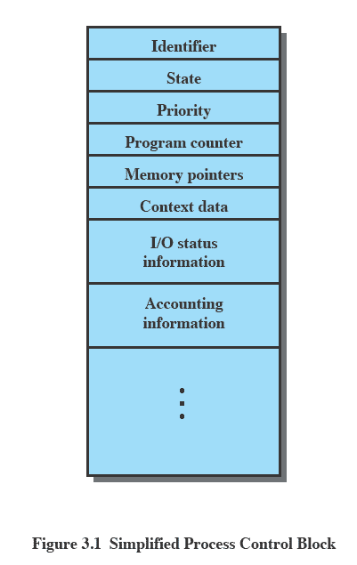
Process Control Block
Contains the process elements
Makes it possible to interrupt a running process and later resume execution as if the interruption had not occurred
Created and managed by the operating system
Key tool that allows support for multiple processes (multiprogramming)
Notes:
The information in the preceding list is stored in a data structure, typically
called a process control block ( Figure 3.1 ), that is created and managed by the OS.
The significant point about the process control block is that it contains sufficient
information so that it is possible to interrupt a running process and later resume
execution as if the interruption had not occurred. The process control block is
the key tool that enables the OS to support multiple processes and to provide for
multiprocessing. When a process is interrupted, the current values of the program
counter and the processor registers (context data) are saved in the appropriate fields
of the corresponding process control block, and the state of the process is changed
to some other value, such as blocked or ready (described subsequently). The OS is
now free to put some other process in the running state. The program counter and
context data for this process are loaded into the processor registers and this process
now begins to execute.
Thus, we can say that a process consists of program code and associated data
plus a process control block. For a single-processor computer, at any given time, at
most one process is executing and that process is in the running state.

Slide 10
Process States
Trace
the behavior of an individual process can be characterized by listing the sequence of instructions that execute for that process
the behavior of the processor can be characterized by showing how the traces of the various processes are interleaved
Dispatcher
small program that switches the processor from one process to another
Notes:
As just discussed, for a program to be executed, a process, or task, is created for
that program. From the processor’s point of view, it executes instructions from its
repertoire in some sequence dictated by the changing values in the program counter
register. Over time, the program counter may refer to code in different programs
that are part of different processes. From the point of view of an individual program,
its execution involves a sequence of instructions within that program.
We can characterize the behavior of an individual process by listing the
sequence of instructions that execute for that process. Such a listing is referred to
as a trace of the process. We can characterize behavior of the processor by showing
how the traces of the various processes are interleaved.

Slide 11
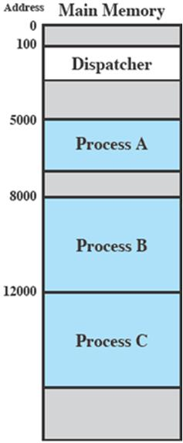
Process Execution
Notes:
Let us consider a very simple example. Figure 3.2 shows a memory layout
of three processes. To simplify the discussion, we assume no use of virtual memory;
thus all three processes are represented by programs that are fully loaded
in main memory. In addition, there is a small dispatcher program that switches
the processor from one process to another.

Slide 12
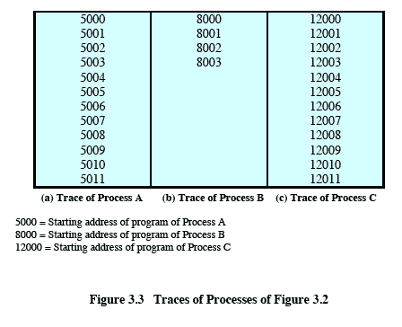
Traces of Processes of Figure 3.2
Each process runs to completion
Figure 3.3
Notes:
Figure 3.3 shows the traces of each
of the processes during the early part of their execution. The first 12 instructions
executed in processes A and C are shown. Process B executes four instructions,
and we assume that the fourth instruction invokes an I/O operation for which the
process must wait.

Slide 13
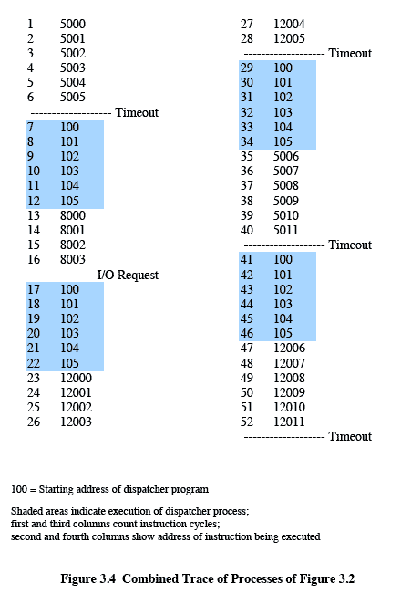
Combined Trace of Processes of Figure 3.2
Figure 3.4
Notes:
Now let us view these traces from the processor’s point of view. Figure 3.4
shows the interleaved traces resulting from the first 52 instruction cycles (for convenience,
the instruction cycles are numbered). In this figure, the shaded areas
represent code executed by the dispatcher. The same sequence of instructions is
executed by the dispatcher in each instance because the same functionality of the
dispatcher is being executed. We assume that the OS only allows a process to continue
execution for a maximum of six instruction cycles, after which it is interrupted;
this prevents any single process from monopolizing processor time. As Figure 3.4
shows, the first six instructions of process A are executed, followed by a time-out
and the execution of some code in the dispatcher, which executes six instructions
before turning control to process B. 2 After four instructions are executed, process
B requests an I/O action for which it must wait. Therefore, the processor stops
executing process B and moves on, via the dispatcher, to process C. After a timeout,
the processor moves back to process A. When this process times out, process
B is still waiting for the I/O operation to complete, so the dispatcher moves on to
process C again.

Slide 14
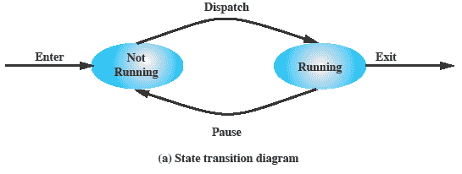
Two-State Process Model
A process may be in one of two states:
running
not-running
Notes:
The operating system’s principal responsibility is controlling the execution of
processes; this includes determining the interleaving pattern for execution and allocating
resources to processes. The first step in designing an OS to control processes
is to describe the behavior that we would like the processes to exhibit.
We can construct the simplest possible model by observing that, at any time, a
process is either being executed by a processor or not. In this model, a process may
be in one of two states: Running or Not Running, as shown in Figure 3.5a . When
the OS creates a new process, it creates a process control block for the process and
enters that process into the system in the Not Running state. The process exists,
is known to the OS, and is waiting for an opportunity to execute. From time to
time, the currently running process will be interrupted and the dispatcher portion
of the OS will select some other process to run. The former process moves from the
Running state to the Not Running state, and one of the other processes moves to
the Running state.

Slide 15
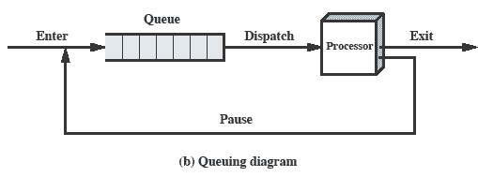
Queuing Diagram
Notes:
From this simple model, we can already begin to appreciate some of the design
elements of the OS. Each process must be represented in some way so that the OS
can keep track of it. That is, there must be some information relating to each process,
including current state and location in memory; this is the process control block.
Processes that are not running must be kept in some sort of queue, waiting their turn
to execute. Figure 3.5b suggests a structure. There is a single queue in which each
entry is a pointer to the process control block of a particular process. Alternatively,
the queue may consist of a linked list of data blocks, in which each block represents
one process; we will explore this latter implementation subsequently.
We can describe the behavior of the dispatcher in terms of this queuing
diagram. A process that is interrupted is transferred to the queue of waiting processes.
Alternatively, if the process has completed or aborted, it is discarded (exits
the system). In either case, the dispatcher takes another process from the queue to
execute.

Slide 16
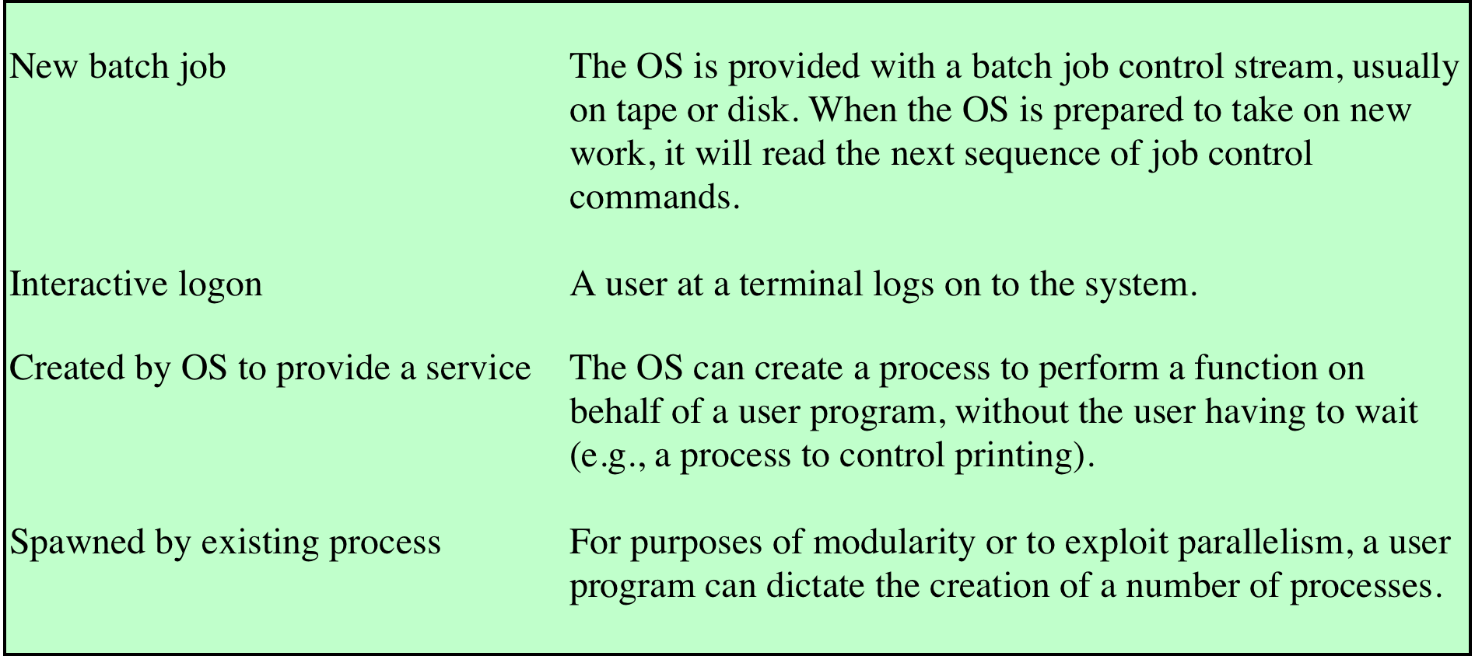
Table 3.1 Reasons for Process Creation
Notes:
When a new process is to be added to those currently being
managed, the OS builds the data structures that are used to manage the process
and allocates address space in main memory to the process. We describe these data
structures in Section 3.3 . These actions constitute the creation of a new process.
Four common events lead to the creation of a process, as indicated in Table 3.1 .
In a batch environment, a process is created in response to the submission of a job.
In an interactive environment, a process is created when a new user attempts to
log on. In both cases, the OS is responsible for the creation of the new process.
An OS may also create a process on behalf of an application. For example, if a
user requests that a file be printed, the OS can create a process that will manage
the printing. The requesting process can thus proceed independently of the time
required to complete the printing task.
Traditionally, the OS created all processes in a way that was transparent to the
user or application program, and this is still commonly found with many contemporary
operating systems. However, it can be useful to allow one process to cause
the creation of another. For example, an application process may generate another
process to receive data that the application is generating and to organize those data
into a form suitable for later analysis. The new process runs in parallel to the original
process and is activated from time to time when new data are available. This
arrangement can be very useful in structuring the application.

Slide 17
Process Creation
Process spawning
when the OS creates a process at the explicit request of another process
Parent process
is the original, creating, process
Child process
is the new process
Notes:
As another example,
a server process (e.g., print server, file server) may generate a new process for each
request that it handles. When the OS creates a process at the explicit request of
another process, the action is referred to as process spawning .
When one process spawns another, the former is referred to as the parent
process , and the spawned process is referred to as the child process . Typically, the
“related” processes need to communicate and cooperate with each other. Achieving
this cooperation is a difficult task for the programmer; this topic is discussed in
Chapter 5 .

Slide 18

Process Termination
There must be a means for a process to indicate its completion
A batch job should include a HALT instruction or an explicit OS service call for termination
For an interactive application, the action of the user will indicate when the process is completed (e.g. log off, quitting an application)
Notes:
Any computer system must provide a means for a process to indicate its
completion. A batch job should include a Halt instruction or an explicit OS service
call for termination. In the former case, the Halt instruction will generate an interrupt
to alert the OS that a process has completed. For an interactive application, the action
of the user will indicate when the process is completed. For example, in a time-sharing
system, the process for a particular user is to be terminated when the user logs off or
turns off his or her terminal. On a personal computer or workstation, a user may quit
an application (e.g., word processing or spreadsheet). All of these actions ultimately
result in a service request to the OS to terminate the requesting process.

Slide 19
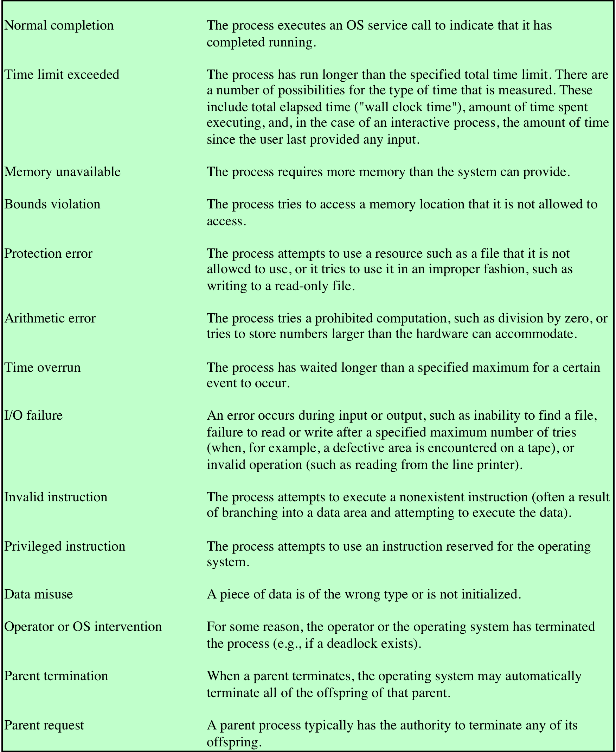
Table 3.2
Reasons for Process Termination
Notes:
Additionally, a number of error and fault conditions can lead to the termination
of a process. Table 3.2 lists some of the more commonly recognized conditions. 3
Finally, in some operating systems, a process may be terminated by the process
that created it or when the parent process is itself terminated.

Slide 20
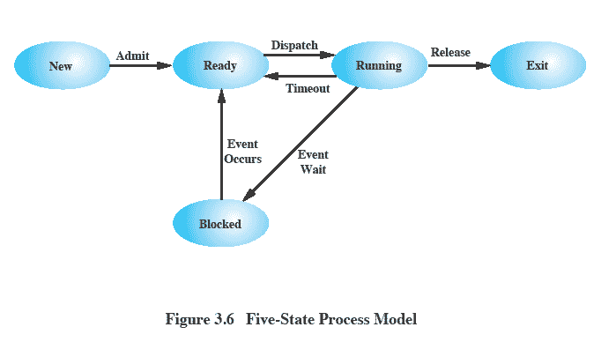
Five-State Process Model
Notes:
If all processes were always ready to execute, then the queuing discipline suggested
by Figure 3.5b would be effective. The queue is a first-in-first-out list and the processor
operates in round-robin fashion on the available processes (each process in
the queue is given a certain amount of time, in turn, to execute and then returned to
the queue, unless blocked). However, even with the simple example that we have
described, this implementation is inadequate: Some processes in the Not Running
state are ready to execute, while others are blocked, waiting for an I/O operation
to complete. Thus, using a single queue, the dispatcher could not just select the
process at the oldest end of the queue. Rather, the dispatcher would have to scan
the list looking for the process that is not blocked and that has been in the queue
the longest.
A more natural way to handle this situation is to split the Not Running state
into two states: Ready and Blocked. This is shown in Figure 3.6 .
The five states in this
new diagram are:
• Running: The process that is currently being executed. For this chapter, we
will assume a computer with a single processor, so at most one process at a
time can be in this state.
• Ready: A process that is prepared to execute when given the opportunity.
• Blocked/Waiting: 4 A process that cannot execute until some event occurs,
such as the completion of an I/O operation.
• New: A process that has just been created but has not yet been admitted to the
pool of executable processes by the OS. Typically, a new process has not yet
been loaded into main memory, although its process control block has been
created.
• Exit: A process that has been released from the pool of executable processes
by the OS, either because it halted or because it aborted for some reason.
Figure 3.6 indicates the types of events that lead to each state transition for a
process; the possible transitions are as follows:
• Null : New: A new process is created to execute a program. This event occurs
for any of the reasons listed in Table 3.1 .
• New : Ready: The OS will move a process from the New state to the Ready
state when it is prepared to take on an additional process. Most systems set
some limit based on the number of existing processes or the amount of virtual
memory committed to existing processes. This limit assures that there are not
so many active processes as to degrade performance.
• Ready : Running: When it is time to select a process to run, the OS chooses
one of the processes in the Ready state. This is the job of the scheduler or
dispatcher. Scheduling is explored in Part Four.
• Running : Exit: The currently running process is terminated by the OS if the
process indicates that it has completed, or if it aborts. See Table 3.2 .
• Running : Ready: The most common reason for this transition is that the
running process has reached the maximum allowable time for uninterrupted
execution; virtually all multiprogramming operating systems impose this type
of time discipline. There are several other alternative causes for this transition,
which are not implemented in all operating systems. Of particular importance
is the case in which the OS assigns different levels of priority to different
processes.
Running : Blocked: A process is put in the Blocked state if it requests something
for which it must wait. A request to the OS is usually in the form of a
system service call; that is, a call from the running program to a procedure
that is part of the operating system code. For example, a process may request
a service from the OS that the OS is not prepared to perform immediately. It
can request a resource, such as a file or a shared section of virtual memory,
that is not immediately available. Or the process may initiate an action, such
as an I/O operation, that must be completed before the process can continue.
When processes communicate with each other, a process may be blocked
when it is waiting for another process to provide data or waiting for a message
from another process.
• Blocked : Ready: A process in the Blocked state is moved to the Ready state
when the event for which it has been waiting occurs.
• Ready : Exit: For clarity, this transition is not shown on the state diagram. In
some systems, a parent may terminate a child’ process at any time. Also, if a parent
terminates, all child processes associated with that parent may be terminated.
• Blocked : Exit: The comments under the preceding item apply.

Slide 21
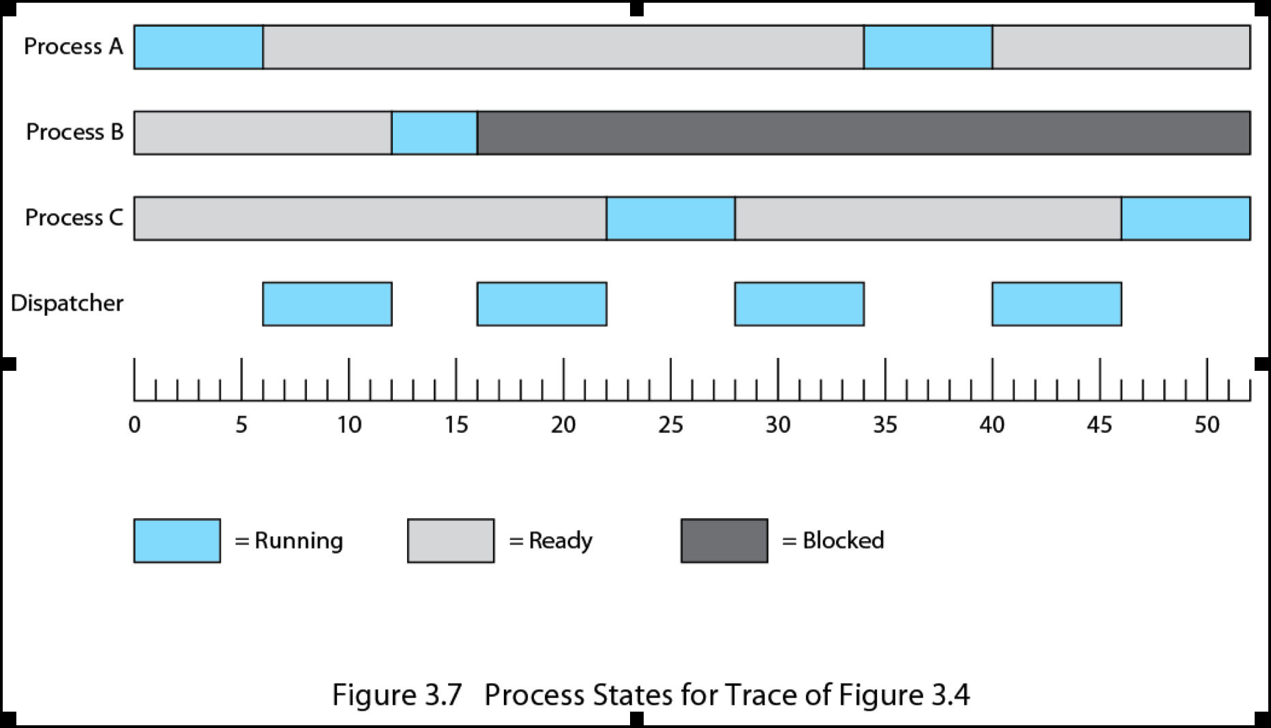
Process States for Trace of Figure 3.4
Notes:
Returning to our simple example, Figure 3.7 shows the transition of each process
among the states.

Slide 22
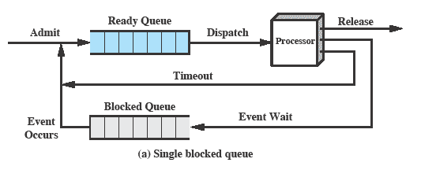
Using Two Queues
Notes:
Figure 3.8a suggests the way in which a queuing discipline
might be implemented with two queues: a Ready queue and a Blocked queue. As
each process is admitted to the system, it is placed in the Ready queue. When it is
time for the OS to choose another process to run, it selects one from the Ready
queue. In the absence of any priority scheme, this can be a simple first-in-first-out
queue. When a running process is removed from execution, it is either terminated
or placed in the Ready or Blocked queue, depending on the circumstances. Finally,
when an event occurs, any process in the Blocked queue that has been waiting on
that event only is moved to the Ready queue.

Slide 23
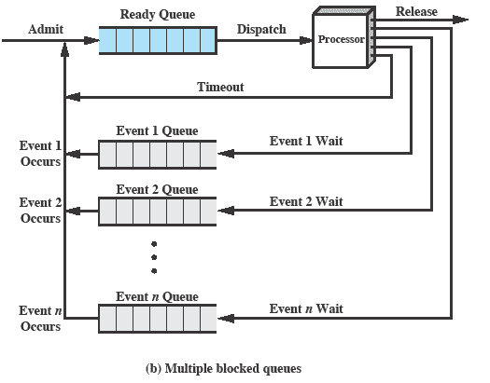
Multiple Blocked Queues
Notes:
This latter arrangement means that, when an event occurs, the OS must scan
the entire blocked queue, searching for those processes waiting on that event. In a
large OS, there could be hundreds or even thousands of processes in that queue.
Therefore, it would be more efficient to have a number of queues, one for each
event. Then, when the event occurs, the entire list of processes in the appropriate
queue can be moved to the Ready state ( Figure 3.8b ).
One final refinement: If the dispatching of processes is dictated by a priority
scheme, then it would be convenient to have a number of Ready queues, one for
each priority level. The OS could then readily determine which is the highest-priority
ready process that has been waiting the longest.

Slide 24
Suspended Processes
Swapping
involves moving part or all of a process from main memory to disk
when none of the processes in main memory is in the Ready state, the OS swaps one of the blocked processes out on to disk into a suspend queue to make room for a new process, or a previously suspended process that is now ready to execute
Commonly used in systems that had no virtual memory; less likely to be used with virtual memory since process size can be controlled through the paging mechanism.
Notes:
Recall that the reason for all of this elaborate machinery is that I/O activities
are much slower than computation and therefore the processor in a uniprogramming
system is idle most of the time. But the arrangement of Figure 3.8b does not entirely
solve the problem. It is true that, in this case, memory holds multiple processes and
that the processor can move to another process when one process is blocked. But the
processor is so much faster than I/O that it will be common for all of the processes in
memory to be waiting for I/O. Thus, even with multiprogramming, a processor could
be idle most of the time.
What to do? Main memory could be expanded to accommodate more processes.
But there are two flaws in this approach. First, there is a cost associated with
main memory, which, though small on a per-byte basis, begins to add up as we get
into the gigabytes of storage. Second, the appetite of programs for memory has
grown as fast as the cost of memory has dropped. So larger memory results in larger
processes, not more processes.
Another solution is swapping, which involves moving part or all of a process
from main memory to disk. When none of the processes in main memory is in the
Ready state, the OS swaps one of the blocked processes out on to disk into a suspend
queue. This is a queue of existing processes that have been temporarily kicked
out of main memory, or suspended. The OS then brings in another process from the
suspend queue, or it honors a new-process request. Execution then continues with
the newly arrived process.
Swapping, however, is an I/O operation, and therefore there is the potential
for making the problem worse, not better. But because disk I/O is generally the
fastest I/O on a system (e.g., compared to tape or printer I/O), swapping will usually
enhance performance.

Slide 25
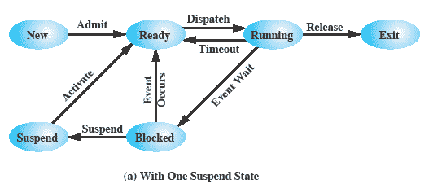
One Suspend State
Notes:
With the use of swapping as just described, one other state must be added to
our process behavior model ( Figure 3.9a ): the Suspend state. When all of the processes
in main memory are in the Blocked state, the OS can suspend one process by
putting it in the Suspend state and transferring it to disk. The space that is freed in
main memory can then be used to bring in another process.
When the OS has performed a swapping-out operation, it has two choices for
selecting a process to bring into main memory: It can admit a newly created process
or it can bring in a previously suspended process. It would appear that the preference
should be to bring in a previously suspended process, to provide it with service
rather than increasing the total load on the system.
But this line of reasoning presents a difficulty. All of the processes that have
been suspended were in the Blocked state at the time of suspension. It clearly would
not do any good to bring a blocked process back into main memory, because it is
still not ready for execution. Recognize, however, that each process in the Suspend
state was originally blocked on a particular event. When that event occurs, the process
is not blocked and is potentially available for execution.

Slide 26
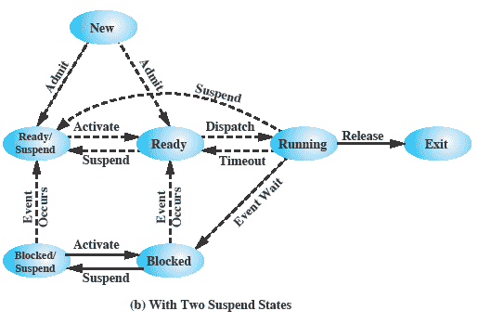
Two Suspend States
Notes:
Let us look now, in Figure 3.9b , at the state transition model that we have
developed. (The dashed lines in the figure indicate possible but not necessary transitions.)
Important new transitions are the following:
• Blocked : Blocked/Suspend: If there are no ready processes, then at least
one blocked process is swapped out to make room for another process that
is not blocked. This transition can be made even if there are ready processes
available, if the OS determines that the currently running process or a ready
process that it would like to dispatch requires more main memory to maintain
adequate performance.
• Blocked/Suspend : Ready/Suspend: A process in the Blocked/Suspend state
is moved to the Ready/Suspend state when the event for which it has been
waiting occurs. Note that this requires that the state information concerning
suspended processes must be accessible to the OS.
• Ready/Suspend : Ready: When there are no ready processes in main memory,
the OS will need to bring one in to continue execution. In addition, it
might be the case that a process in the Ready/Suspend state has higher priority
than any of the processes in the Ready state. In that case, the OS designer may
dictate that it is more important to get at the higher-priority process than to
minimize swapping.
• Ready : Ready/Suspend: Normally, the OS would prefer to suspend a
blocked process rather than a ready one, because the ready process can now
be executed, whereas the blocked process is taking up main memory space
and cannot be executed. However, it may be necessary to suspend a ready
process if that is the only way to free up a sufficiently large block of main
memory. Also, the OS may choose to suspend a lower–priority ready process
rather than a higher–priority blocked process if it believes that the blocked
process will be ready soon.

Slide 27
Characteristics of a Suspended Process
The process is not immediately available for execution
The process may or may not be waiting on an event
The process was placed in a suspended state by an agent: either itself, a parent process, or the OS, for the purpose of preventing its execution
The process may not be removed from this state until the agent explicitly orders the removal
Notes:
We can generalize the concept of a suspended process. Let us define a
suspended process as having the following characteristics:
1. The process is not immediately available for execution.
2. The process may or may not be waiting on an event. If it is, this blocked condition
is independent of the suspend condition, and occurrence of the blocking
event does not enable the process to be executed immediately.
The process was placed in a suspended state by an agent: either itself, a parent
process, or the OS, for the purpose of preventing its execution.
4. The process may not be removed from this state until the agent explicitly
orders the removal.

Slide 28
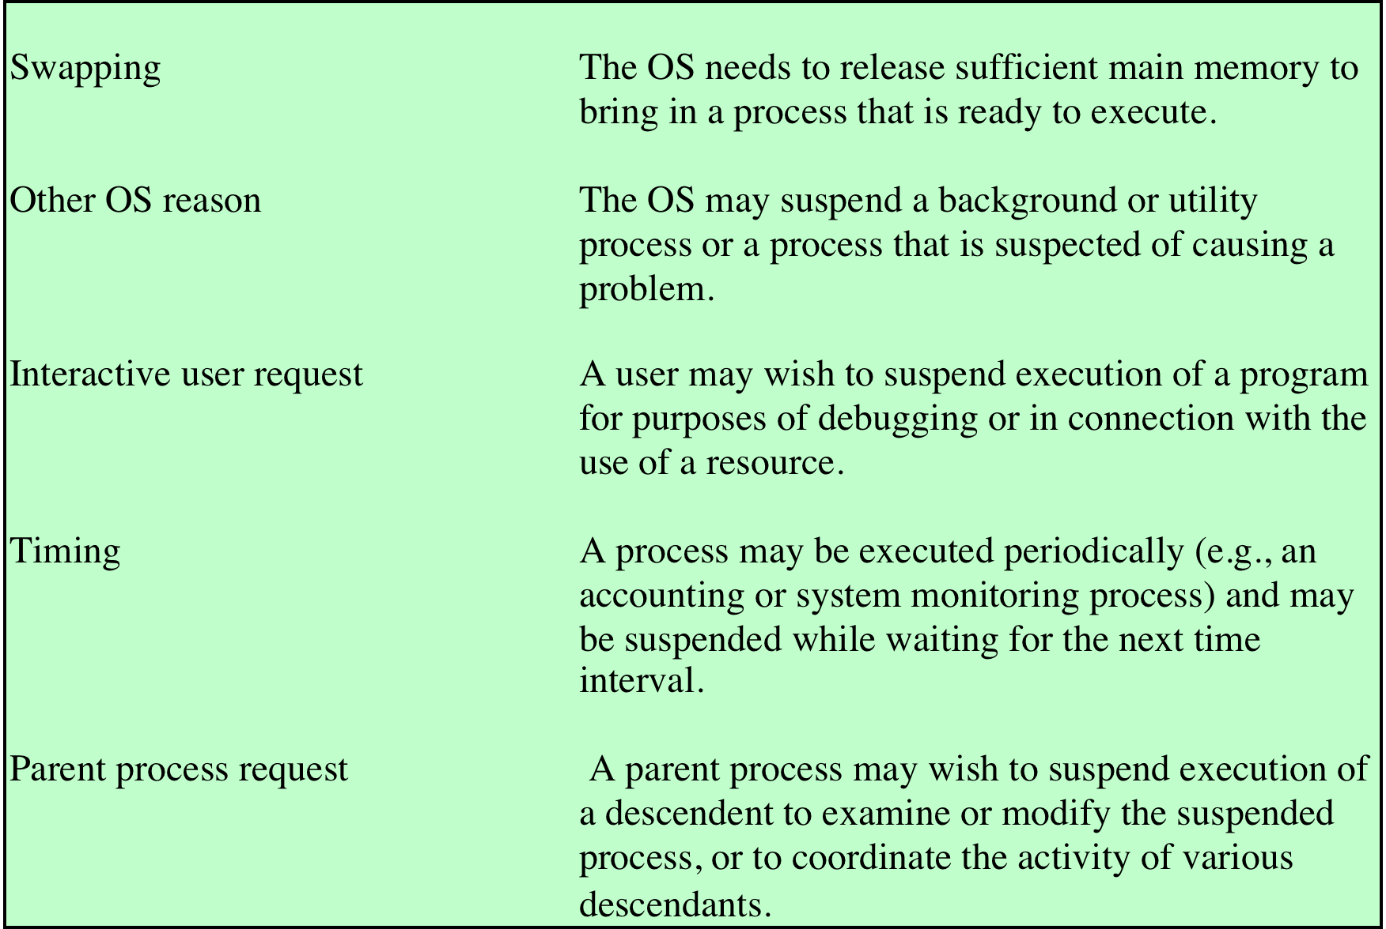
Reasons for Process Suspension
Table 3.3 Reasons for Process Suspension
Notes:
Table 3.3 lists some reasons for the suspension of a process. One reason that
we have discussed is to provide memory space either to bring in a Ready/Suspended
process or to increase the memory allocated to other Ready processes. The OS may
have other motivations for suspending a process. For example, an auditing or tracing
process may be employed to monitor activity on the system; the process may
be used to record the level of utilization of various resources (processor, memory,
channels) and the rate of progress of the user processes in the system. The OS,
under operator control, may turn this process on and off from time to time. If the
OS detects or suspects a problem, it may suspend a process. One example of this
is deadlock, which is discussed in Chapter 6 . As another example, a problem is
detected on a communications line, and the operator has the OS suspend the process
that is using the line while some tests are run.
Another set of reasons concerns the actions of an interactive user. For example, if
a user suspects a bug in the program, he or she may debug the program by suspending
its execution, examining and modifying the program or data, and resuming execution.
Or there may be a background process that is collecting trace or accounting statistics,
which the user may wish to be able to turn on and off.
Timing considerations may also lead to a swapping decision. For example, if a
process is to be activated periodically but is idle most of the time, then it should be
swapped out between uses. A program that monitors utilization or user activity is
an example.
Finally, a parent process may wish to suspend a descendent process. For example,
process A may spawn process B to perform a file read. Subsequently, process B
encounters an error in the file read procedure and reports this to process A. Process
A suspends process B to investigate the cause.
In all of these cases, the activation of a suspended process is requested by the
agent that initially requested the suspension.

Slide 29
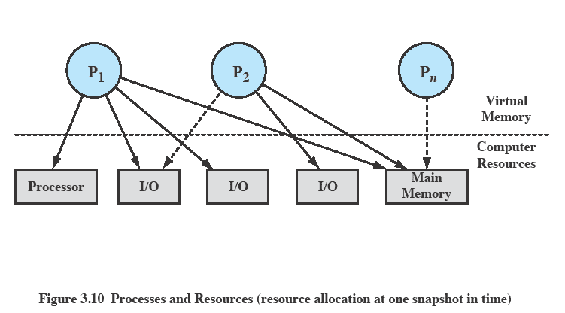
Processes and Resources What does the OS need to know to manage processes & resources?
Notes:
The OS controls events within the computer system. It schedules and dispatches
processes for execution by the processor, allocates resources to processes, and
responds to requests by user processes for basic services. Fundamentally, we can
think of the OS as that entity that manages the use of system resources by processes.
This concept is illustrated in Figure 3.10 . In a multiprogramming environment,
there are a number of processes (P 1 ,…, P n ) that have been created and exist in
virtual memory. Each process, during the course of its execution, needs access to
certain system resources, including the processor, I/O devices, and main memory. In
the figure, process P 1 is running; at least part of the process is in main memory, and
it has control of two I/O devices. Process P 2 is also in main memory but is blocked
waiting for an I/O device allocated to P 1 . Process P n has been swapped out and is
therefore suspended.

Slide 30
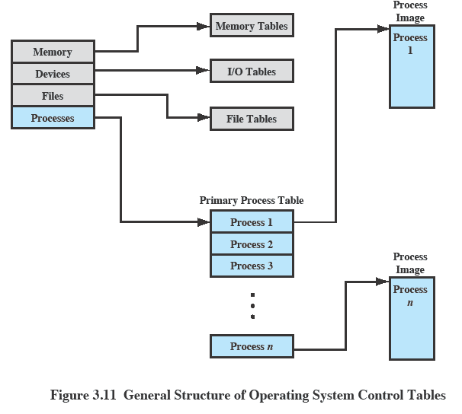
OS Control Tables
Notes:
If the OS is to manage processes and resources, it must have information about
the current status of each process and resource. The universal approach to providing
this information is straightforward: The OS constructs and maintains tables of
information about each entity that it is managing. A general idea of the scope of this
effort is indicated in Figure 3.11 , which shows four different types of tables maintained
by the OS: memory, I/O, file, and process. Although the details will differ
from one OS to another, fundamentally, all operating systems maintain information
in these four categories.
Figure 3.11 depicts the structure of the location information in the following
way. There is a primary process table with one entry for each process. Each
entry contains, at least, a pointer to a process image. If the process image contains
multiple blocks, this information is contained directly in the primary process
table or is available by cross-reference to entries in memory tables. Of course,
this depiction is generic; a particular OS will have its own way of organizing the
location information.

Slide 31
Memory Tables
Used to keep track of both main (real) and secondary (virtual) memory
Processes are maintained on secondary memory using some sort of virtual memory or simple swapping mechanism
Must include:
allocation of main memory to processes
allocation of secondary memory to processes
protection attributes of blocks of main or virtual memory
information needed to manage virtual memory
Notes:
Memory tables are used to keep track of both main (real) and secondary
(virtual) memory. Some of main memory is reserved for use by the OS; the
remainder is available for use by processes. Processes are maintained on secondary
memory using some sort of virtual memory or simple swapping mechanism. The
memory tables must include the following information:
• The allocation of main memory to processes
• The allocation of secondary memory to processes
Any protection attributes of blocks of main or virtual memory, such as which
processes may access certain shared memory regions
• Any information needed to manage virtual memory
We examine the information structures for memory management in detail in Part
Three.

Slide 32
I/O Tables
Used by the OS to manage the I/O devices and channels of the computer system
At any given time, an I/O device may be available or assigned to a particular process
If an I/O operation is in progress, the OS needs to know:
the status of the I/O operation
the location in main memory being used as the source or destination of the I/O transfer
Notes:
I/O tables are used by the OS to manage the I/O devices and channels of the
computer system. At any given time, an I/O device may be available or assigned to a
particular process. If an I/O operation is in progress, the OS needs to know the status
of the I/O operation and the location in main memory being used as the source or
destination of the I/O transfer. I/O management is examined in Chapter 11 .

Slide 33
File Tables
These tables provide information about:
existence of files
location on secondary memory
current status
other attributes
Information may be maintained and used by a file management system, or the OS itself
Notes:
The OS may also maintain file tables.
Much, if not all, of this information may be maintained and used by a file management system, in which case the OS has little or no knowledge of files.
In other operating systems, much of the detail of file management is managed by the OS itself.

Slide 34
Process Tables
Must be maintained to manage processes
Process tables must have some reference to memory, I/O, and file tables
e.g., pointers from each individual process entry to its data in the other three sets of tables.
The tables themselves must be accessible by the OS and therefore are subject to memory management
Processes are represented by a process image
Notes:
Finally, the OS must maintain process tables to manage processes. The
remainder of this section is devoted to an examination of the required process
tables. Before proceeding to this discussion, two additional points should be made.
First, although Figure 3.11 shows four distinct sets of tables, it should be clear that
these tables must be linked or cross-referenced in some fashion. Memory, I/O, and
files are managed on behalf of processes, so there must be some reference to these
resources, directly or indirectly, in the process tables. The files referred to in the file
tables are accessible via an I/O device and will, at some times, be in main or virtual
memory. The tables themselves must be accessible by the OS and therefore are subject
to memory management.
Second, how does the OS know to create the tables in the first place? Clearly,
the OS must have some knowledge of the basic environment, such as how much main
memory exists, what are the I/O devices and what are their identifiers, and so on. This
is an issue of configuration. That is, when the OS is initialized, it must have access to
some configuration data that define the basic environment, and these data must be
created outside the OS, with human assistance or by some auto configuration software.

Slide 35
Process Control Structures - PCB
Process Components
Process Attributes
A process must include a program or set of programs to be executed
A process will consist of at least sufficient memory to hold the program(s) and data of that process
The execution of a program typically involves a stack that is used to keep track of procedure calls and parameter passing between procedures
Each process has associated with it a number of attributes that are used by the OS for process control –maintained in a Process Control Block (PCB)
The collection of program, data, stack, and attributes is referred to as the process image
Process image location will depend on the memory management scheme being used
Notes:
Before we can deal with the questions of where a process is
located or what its attributes are, we need to address an even more fundamental
question: What is the physical manifestation of a process? At a minimum, a process
must include a program or set of programs to be executed. Associated with these
programs is a set of data locations for local and global variables and any defined
constants. Thus, a process will consist of at least sufficient memory to hold the
programs and data of that process. In addition, the execution of a program typically
involves a stack (see Appendix P) that is used to keep track of procedure calls and
parameter passing between procedures. Finally, each process has associated with it
a number of attributes that are used by the OS for process control.
The location of a process image will depend on the memory management
scheme being used. In the simplest case, the process image is maintained as a
contiguous, or continuous, block of memory. This block is maintained in secondary
memory, usually disk. So that the OS can manage the process, at least a small portion
of its image must be maintained in main memory. To execute the process, the entire
process image must be loaded into main memory or at least virtual memory. Thus,
the OS needs to know the location of each process on disk and, for each such process
that is in main memory, the location of that process in main memory. We saw
a slightly more complex variation on this scheme with the CTSS OS, in Chapter 2 .
With CTSS, when a process is swapped out, part of the process image may remain in
main memory. Thus, the OS must keep track of which portions of the image of each
process are still in main memory.
Modern operating systems presume paging hardware that allows noncontiguous
physical memory to support partially resident processes. 8 At any given time, a
portion of a process image may be in main memory, with the remainder in secondary
memory. 9 Therefore, process tables maintained by the OS must show the location
of each page of each process image.

Slide 36

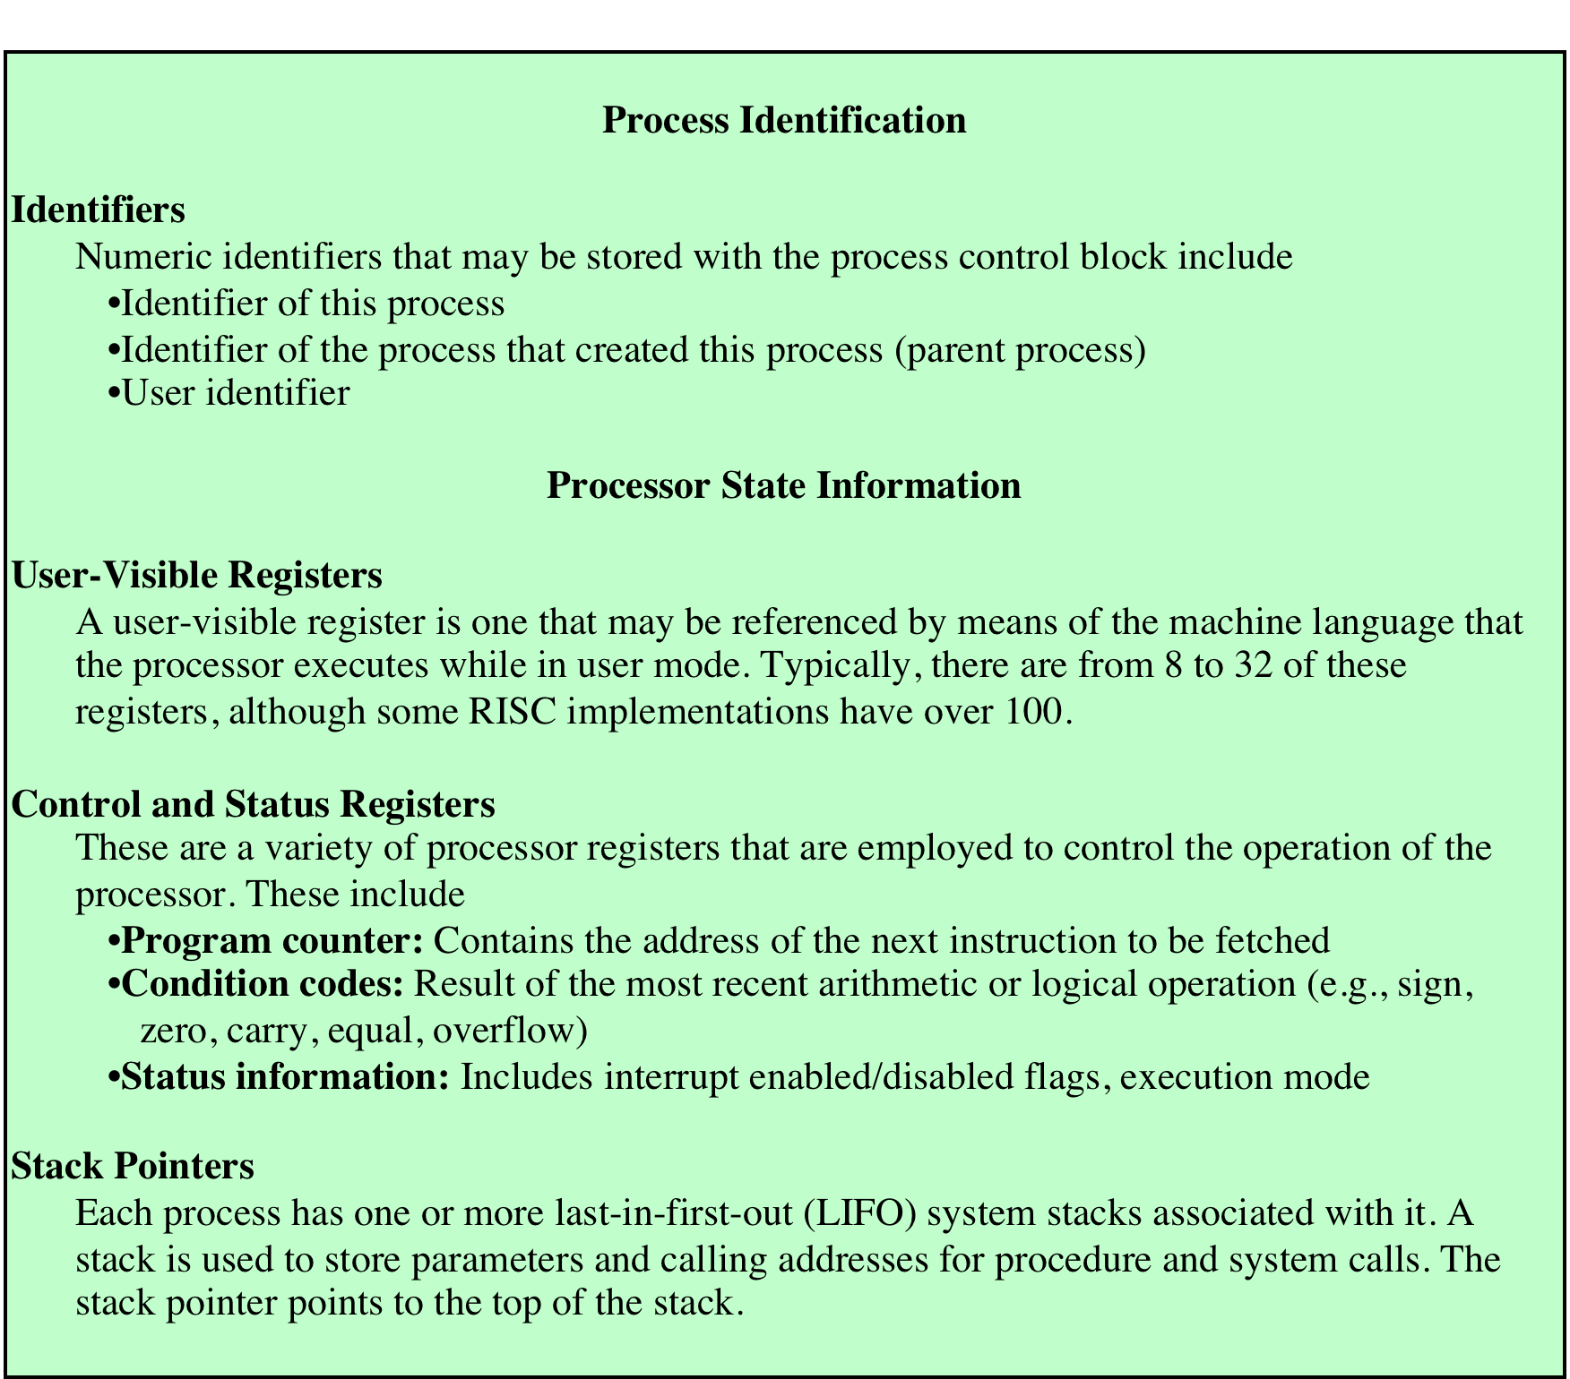
Process Attributes
Notes:
A sophisticated multiprogramming system requires a great
deal of information about each process. As was explained, this information can be
considered to reside in a process control block. Different systems will organize this
information in different ways, and several examples of this appear at the end of this
chapter and the next. For now, let us simply explore the type of information that
might be of use to an OS without considering in any detail how that information is
organized.
Table 3.5 lists the typical categories of information required by the OS for each
process. You may be somewhat surprised at the quantity of information required.
As you gain a greater appreciation of the responsibilities of the OS, this list should
appear more reasonable.
We can group the process control block information into three general
categories:
• Process identification
• Processor state information
• Process control information

Slide 37
Process Identification
Memory tables may be organized to provide a map of main memory with an indication of which process is assigned to each region
similar references will appear in I/O and file tables
When processes communicate with one another, the process identifier informs the OS of the destination of a particular communication
When processes are allowed to create other processes, identifiers indicate the parent and descendents of each process
Each process is assigned a unique numeric identifier
otherwise there must be a mapping that allows the OS to locate the appropriate tables based on the process identifier
Many of the tables controlled by the OS may use process identifiers to cross-reference process tables
Notes:
With respect to process identification , in virtually all operating systems, each
process is assigned a unique numeric identifier, which may simply be an index into
the primary process table ( Figure 3.11 ); otherwise there must be a mapping that
allows the OS to locate the appropriate tables based on the process identifier. This
identifier is useful in several ways. Many of the other tables controlled by the OS
may use process identifiers to cross-reference process tables. For example, the
memory tables may be organized so as to provide a map of main memory with an
indication of which process is assigned to each region. Similar references will appear
in I/O and file tables. When processes communicate with one another, the process
identifier informs the OS of the destination of a particular communication. When
processes are allowed to create other processes, identifiers indicate the parent and
descendents of each process.
In addition to these process identifiers, a process may be assigned a user identifier
that indicates the user responsible for the job.

Slide 38
Processor State Information
Consists of the contents of processor registers
user-visible registers
control and status registers
stack pointers
Program status word (PSW)
contains condition codes plus other status information
EFLAGS register is an example of a PSW used by any OS running on an x86 processor
Notes:
Processor state information consists of the contents of processor registers.
While a process is running, of course, the information is in the registers. When a
process is interrupted, all of this register information must be saved so that it can
be restored when the process resumes execution. The nature and number of registers
involved depend on the design of the processor. Typically, the register set will
include user-visible registers, control and status registers, and stack pointers. These
are described in Chapter 1 .
Of particular note, all processor designs include a register or set of registers,
often known as the program status word (PSW), that contains status information.
The PSW typically contain condition codes plus other status information. A good
example of a processor status word is that on Intel x86 processors, referred to as the
EFLAGS register (shown in Figure 3.12 and Table 3.6 ). This structure is used by
any OS (including UNIX and Windows) running on an x86 processor.

Slide 39
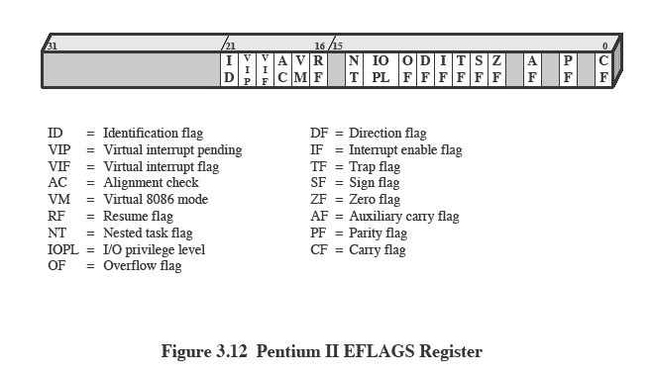
X86 EFLAGS Register
Notes:
Figure 3.12 x86 EFLAGS register.
(See also Table 3.6)

Slide 40
Process Control Information
The additional information needed by the OS to control and coordinate the various active processes
Forms the 3rd part of the PCB (along with process ID and processor state information)
Notes:
The third major category of information in the process control block can be
called, for want of a better name, process control information . This is the additional
information needed by the OS to control and coordinate the various active
processes. The last part of Table 3.5 indicates the scope of this information. As
we examine the details of operating system functionality in succeeding chapters,
the need for the various items on this list should become clear.

Slide 41
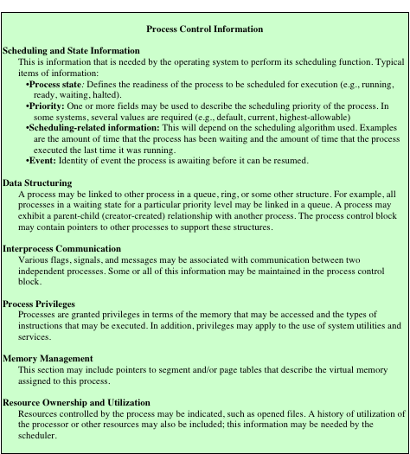
Typical
Elements
of a Process
Control Block
Notes:
Table 3.5 (continued)

Slide 42
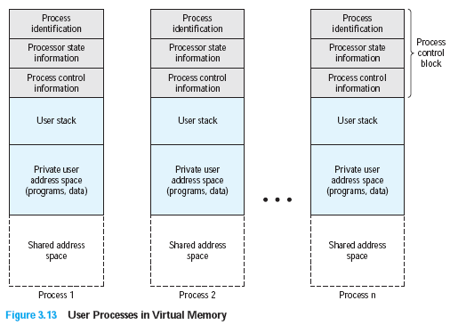
Structure of Process Images in Virtual Memory
Notes:
Figure 3.13 suggests the structure of process images in virtual memory. Each
process image consists of a process control block, a user stack, the private address
space of the process, and any other address space that the process shares with
other processes. In the figure, each process image appears as a contiguous range
of addresses. In an actual implementation, this may not be the case; it will depend
on the memory management scheme and the way in which control structures are
organized by the OS.

Slide 43
Role of the Process Control Block
The most important data structure in an OS
contains all of the information about a process that is needed by the OS
blocks are read and/or modified by virtually every module in the OS
defines the state of the OS
Difficulty is not access, but protection
a bug in a single routine could damage process control blocks, which could destroy the system’s ability to manage the affected processes
a design change in the structure or semantics of the process control block could affect a number of modules in the OS
Notes:
The process control block is the
most important data structure in an OS. Each process control block contains all
of the information about a process that is needed by the OS. The blocks are read
and/or modified by virtually every module in the OS, including those involved with
scheduling, resource allocation, interrupt processing, and performance monitoring
and analysis. One can say that the set of process control blocks defines the state of
the OS.
This brings up an important design issue. A number of routines within the OS
will need access to information in process control blocks. The provision of direct
access to these tables is not difficult. Each process is equipped with a unique ID, and
this can be used as an index into a table of pointers to the process control blocks.
The difficulty is not access but rather protection. Two problems present themselves:
• A bug in a single routine, such as an interrupt handler, could damage process
control blocks, which could destroy the system’s ability to manage the affected
processes.
• A design change in the structure or semantics of the process control block
could affect a number of modules in the OS.
These problems can be addressed by requiring all routines in the OS to go
through a handler routine, the only job of which is to protect process control blocks,
and which is the sole arbiter for reading and writing these blocks. The trade-off in
the use of such a routine involves performance issues and the degree to which the
remainder of the system software can be trusted to be correct.

Slide 44

Modes of Execution
User Mode
System Mode
less-privileged mode
user programs typically execute in this mode
more-privileged mode
also referred to as control mode or kernel mode
kernel of the operating system
Notes:
Before continuing with our discussion of the way in which the OS manages processes,
we need to distinguish between the mode of processor execution normally
associated with the OS and that normally associated with user programs. Most
processors support at least two modes of execution. Certain instructions can only
be executed in the more-privileged mode. These would include reading or altering
a control register, such as the program status word; primitive I/O instructions;
and instructions that relate to memory management. In addition, certain regions of
memory can only be accessed in the more-privileged mode.
The less-privileged mode is often referred to as the user mode , because user
programs typically would execute in this mode. The more-privileged mode is referred
to as the system mode , control mode , or kernel mode . This last term refers to the
kernel of the OS, which is that portion of the OS that encompasses the important
system functions.

Slide 45
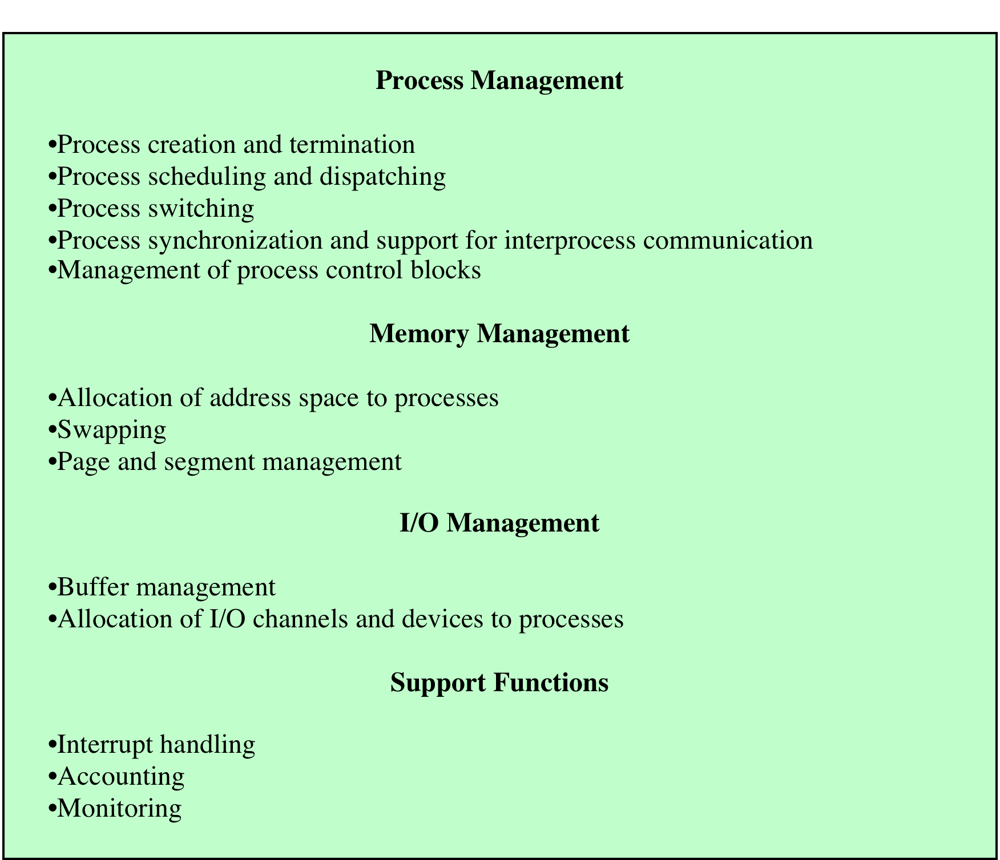
Typical
Functions
of an
Operating
System
Kernel
Notes:
Table 3.7 lists the functions typically found in the kernel of an OS.

Slide 46
Process Creation
Once the OS decides to create a new process it:
assigns a unique process identifier to the new process
allocates space for the process
initializes the process control block
sets the appropriate linkages
creates or expands other data structures
Notes:
Once the OS decides, for whatever reason ( Table 3.1 ), to create a new process,
it can proceed as follows:
1. Assign a unique process identifier to the new process. At this time, a new entry
is added to the primary process table, which contains one entry per process.
2. Allocate space for the process. This includes all elements of the process image.
Thus, the OS must know how much space is needed for the private user address
space (programs and data) and the user stack. These values can be assigned by
default based on the type of process, or they can be set based on user request
at job creation time. If a process is spawned by another process, the parent
process can pass the needed values to the OS as part of the process-creation
request. If any existing address space is to be shared by this new process, the
appropriate linkages must be set up. Finally, space for a process control block
must be allocated.
3. Initialize the process control block. The process identification portion contains
the ID of this process plus other appropriate IDs, such as that of the parent
process. The processor state information portion will typically be initialized
with most entries zero, except for the program counter (set to the program
entry point) and system stack pointers (set to define the process stack boundaries).
The process control information portion is initialized based on standard
default values plus attributes that have been requested for this process. For
example, the process state would typically be initialized to Ready or Ready/
Suspend. The priority may be set by default to the lowest priority unless an
explicit request is made for a higher priority. Initially, the process may own
no resources (I/O devices, files) unless there is an explicit request for these or
unless they are inherited from the parent.
4. Set the appropriate linkages. For example, if the OS maintains each scheduling
queue as a linked list, then the new process must be put in the Ready or
Ready/Suspend list.
5. Create or expand other data structures. For example, the OS may maintain
an accounting file on each process to be used subsequently for billing and/or
performance assessment purposes.

Slide 47
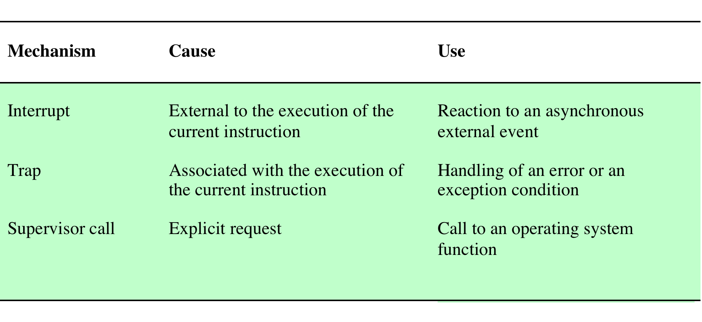
Process (Context) Switching
A process switch may occur any time that the OS has gained control from the currently running process. Possible events giving OS control are:
Notes:
A process switch may occur any time that the OS has
gained control from the currently running process. Table 3.8 suggests the possible
events that may give control to the OS.

Slide 48
System Interrupts
Interrupt
Trap
Due to some sort of event that is external to and independent of the currently running process
clock interrupt
I/O interrupt
memory fault
Time slice
the maximum amount of time that a process can execute before being interrupted
An error or exception condition generated within the currently running process
OS determines if the condition is fatal
moved to the Exit state and a process switch occurs
action will depend on the nature of the error
Notes:
First, let us consider system interrupts. Actually, we can distinguish, as many
systems do, two kinds of system interrupts, one of which is simply referred to as an
interrupt, and the other as a trap. The former is due to some sort of event that is
external to and independent of the currently running process, such as the completion
of an I/O operation. The latter relates to an error or exception condition generated
within the currently running process, such as an illegal file access attempt. With an
ordinary interrupt , control is first transferred to an interrupt handler, which does
some basic housekeeping and then branches to an OS routine that is concerned with
the particular type of interrupt that has occurred. Examples include the following:
• Clock interrupt: The OS determines whether the currently running process
has been executing for the maximum allowable unit of time, referred to as a
time slice . That is, a time slice is the maximum amount of time that a process
can execute before being interrupted. If so, this process must be switched to a
Ready state and another process dispatched.
• I/O interrupt: The OS determines what I/O action has occurred. If the I/O
action constitutes an event for which one or more processes are waiting,
then the OS moves all of the corresponding blocked processes to the Ready
state (and Blocked/Suspend processes to the Ready/Suspend state). The OS
must then decide whether to resume execution of the process currently in
the Running state or to preempt that process for a higher-priority Ready
process.
• Memory fault: The processor encounters a virtual memory address reference
for a word that is not in main memory. The OS must bring in the block
(page or segment) of memory containing the reference from secondary memory
to main memory. After the I/O request is issued to bring in the block of
memory, the process with the memory fault is placed in a blocked state; the
OS then performs a process switch to resume execution of another process.
After the desired block is brought into memory, that process is placed in the
Ready state.
With a trap , the OS determines if the error or exception condition is fatal.
If so, then the currently running process is moved to the Exit state and a process
switch occurs. If not, then the action of the OS will depend on the nature of
the error and the design of the OS. It may attempt some recovery procedure or
simply notify the user. It may do a process switch or resume the currently running
process.

Slide 49
Mode Switching
If no interrupts are pending the processor:
proceeds to the fetch stage and fetches the next instruction of the current program in the current process
If an interrupt is pending the processor:
sets the program counter to the starting address of an interrupt handler program
switches from user mode to kernel mode so that the interrupt processing code may include privileged instructions
Notes:
In Chapter 1 , we discussed the inclusion of an interrupt stage as
part of the instruction cycle. Recall that, in the interrupt stage, the processor checks
to see if any interrupts are pending, indicated by the presence of an interrupt signal.
If no interrupts are pending, the processor proceeds to the fetch stage and fetches
the next instruction of the current program in the current process. If an interrupt is
pending, the processor does the following:
1. It sets the program counter to the starting address of an interrupt handler
program.
2. It switches from user mode to kernel mode so that the interrupt processing
code may include privileged instructions.
The processor now proceeds to the fetch stage and fetches the first instruction of
the interrupt handler program, which will service the interrupt. At this point, typically,
the context of the process that has been interrupted is saved into that process
control block of the interrupted program.
One question that may now occur to you is, What constitutes the context that
is saved? The answer is that it must include any information that may be altered by
the execution of the interrupt handler and that will be needed to resume the program
that was interrupted. Thus, the portion of the process control block that was
referred to as processor state information must be saved. This includes the program
counter, other processor registers, and stack information.
Does anything else need to be done? That depends on what happens next. The
interrupt handler is typically a short program that performs a few basic tasks related
to an interrupt. For example, it resets the flag or indicator that signals the presence
of an interrupt. It may send an acknowledgment to the entity that issued the interrupt,
such as an I/O module. And it may do some basic housekeeping relating to the
effects of the event that caused the interrupt. For example, if the interrupt relates
to an I/O event, the interrupt handler will check for an error condition. If an error
has occurred, the interrupt handler may send a signal to the process that originally
requested the I/O operation. If the interrupt is by the clock, then the handler will
hand control over to the dispatcher, which will want to pass control to another process
because the time slice allotted to the currently running process has expired.
What about the other information in the process control block? If this interrupt
is to be followed by a switch to another process, then some work will need to be
done. However, in most operating systems, the occurrence of an interrupt does not
necessarily mean a process switch. It is possible that, after the interrupt handler has
executed, the currently running process will resume execution. In that case, all that
is necessary is to save the processor state information when the interrupt occurs and
restore that information when control is returned to the program that was running.
Typically, the saving and restoring functions are performed in hardware.

Slide 50
Mode Switching
A mode switch is distinct from a process switch.
A mode switch can take place without changing the state of the executing process
However, while processing a mode switch the OS may decide a process switch is needed; e.g., if the mode switch was caused by a timer interrupt or a process request for I/O
Notes:
In Chapter 1 , we discussed the inclusion of an interrupt stage as
part of the instruction cycle. Recall that, in the interrupt stage, the processor checks
to see if any interrupts are pending, indicated by the presence of an interrupt signal.
If no interrupts are pending, the processor proceeds to the fetch stage and fetches
the next instruction of the current program in the current process. If an interrupt is
pending, the processor does the following:
1. It sets the program counter to the starting address of an interrupt handler
program.
2. It switches from user mode to kernel mode so that the interrupt processing
code may include privileged instructions.
The processor now proceeds to the fetch stage and fetches the first instruction of
the interrupt handler program, which will service the interrupt. At this point, typically,
the context of the process that has been interrupted is saved into that process
control block of the interrupted program.
One question that may now occur to you is, What constitutes the context that
is saved? The answer is that it must include any information that may be altered by
the execution of the interrupt handler and that will be needed to resume the program
that was interrupted. Thus, the portion of the process control block that was
referred to as processor state information must be saved. This includes the program
counter, other processor registers, and stack information.
Does anything else need to be done? That depends on what happens next. The
interrupt handler is typically a short program that performs a few basic tasks related
to an interrupt. For example, it resets the flag or indicator that signals the presence
of an interrupt. It may send an acknowledgment to the entity that issued the interrupt,
such as an I/O module. And it may do some basic housekeeping relating to the
effects of the event that caused the interrupt. For example, if the interrupt relates
to an I/O event, the interrupt handler will check for an error condition. If an error
has occurred, the interrupt handler may send a signal to the process that originally
requested the I/O operation. If the interrupt is by the clock, then the handler will
hand control over to the dispatcher, which will want to pass control to another process
because the time slice allotted to the currently running process has expired.
What about the other information in the process control block? If this interrupt
is to be followed by a switch to another process, then some work will need to be
done. However, in most operating systems, the occurrence of an interrupt does not
necessarily mean a process switch. It is possible that, after the interrupt handler has
executed, the currently running process will resume execution. In that case, all that
is necessary is to save the processor state information when the interrupt occurs and
restore that information when control is returned to the program that was running.
Typically, the saving and restoring functions are performed in hardware.

Slide 51
Change of Process State
The steps in a full process switch are:
save the context of the processor
update the process control block of the process currently in the Running state
move the process control block of this process to the appropriate queue
select another process for execution
update the process control block of the process selected
update memory management data structures
restore the context of the processor to that which existed at the time the selected process was last switched out
If the currently running process is to be moved to another state (Ready, Blocked, etc.), then the OS must make substantial changes in its environment
Notes:
It is clear, then, that the mode switch is a concept
distinct from that of the process switch. 10 A mode switch may occur without
changing the state of the process that is currently in the Running state. In that case,
the context saving and subsequent restoral involve little overhead. However, if the
currently running process is to be moved to another state (Ready, Blocked, etc.),
then the OS must make substantial changes in its environment. The steps involved
in a full process switch are as follows:
1. Save the context of the processor, including program counter and other
registers.
2. Update the process control block of the process that is currently in the
Running state. This includes changing the state of the process to one of the
other states (Ready; Blocked; Ready/Suspend; or Exit). Other relevant fields
must also be updated, including the reason for leaving the Running state and
accounting information.
3. Move the process control block of this process to the appropriate queue
(Ready; Blocked on Event i ; Ready/Suspend).
4. Select another process for execution; this topic is explored in Part Four.
5. Update the process control block of the process selected. This includes changing
the state of this process to Running.
6. Update memory management data structures. This may be required, depending
on how address translation is managed; this topic is explored in Part Three.
7. Restore the context of the processor to that which existed at the time the
selected process was last switched out of the Running state, by loading in the
previous values of the program counter and other registers.
Thus, the process switch, which involves a state change, requires more effort than a
mode switch.

Slide 52
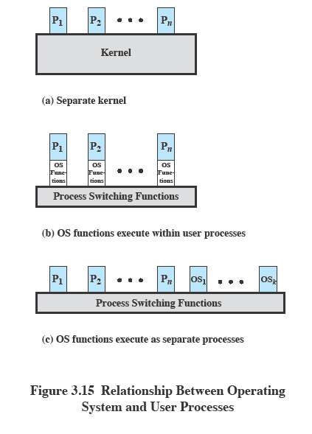
Execution of the Operating System
Notes:
One traditional approach, common on many older operating systems, is to execute
the kernel of the OS outside of any process ( Figure 3.15a ). With this approach,
when the currently running process is interrupted or issues a supervisor call, the
mode context of this process is saved and control is passed to the kernel. The OS has
its own region of memory to use and its own system stack for controlling procedure
calls and returns. The OS can perform any desired functions and restore the context
of the interrupted process, which causes execution to resume in the interrupted
user process. Alternatively, the OS can complete the function of saving the environment
of the process and proceed to schedule and dispatch another process. Whether
this happens depends on the reason for the interruption and the circumstances at
the time.
In any case, the key point here is that the concept of process is considered to
apply only to user programs. The operating system code is executed as a separate
entity that operates in privileged mode.
Execution within User Processes
An alternative that is common with operating systems on smaller computers (PCs,
workstations) is to execute virtually all OS software in the context of a user process.
The view is that the OS is primarily a collection of routines that the user calls to
perform various functions, executed within the environment of the user’s process.
This is illustrated in Figure 3.15b . At any given point, the OS is managing n process
images. Each image includes not only the regions illustrated in Figure 3.13 , but also
program, data, and stack areas for kernel programs.
Process-Based Operating System
Another alternative, illustrated in Figure 3.15c , is to implement the OS as a collection
of system processes. As in the other options, the software that is part of the
kernel executes in a kernel mode. In this case, however, major kernel functions are
organized as separate processes. Again, there may be a small amount of process switching
code that is executed outside of any process.
This approach has several advantages. It imposes a program design discipline
that encourages the use of a modular OS with minimal, clean interfaces between the
modules. In addition, some noncritical operating system functions are conveniently
implemented as separate processes. For example, we mentioned earlier a monitor
program that records the level of utilization of various resources (processor, memory,
channels) and the rate of progress of the user processes in the system. Because
this program does not provide a particular service to any active process, it can only
be invoked by the OS. As a process, the function can run at an assigned priority
level and be interleaved with other processes under dispatcher control. Finally,
implementing the OS as a set of processes is useful in a multiprocessor or multicomputer
environment, in which some of the operating system services can be shipped
out to dedicated processors, improving performance.

Slide 53
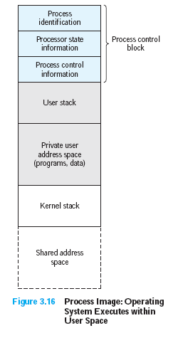
Execution Within User Processes
Notes:
Figure 3.16 suggests a typical process image structure for this strategy. A separate
kernel stack is used to manage calls/returns while the process is in kernel mode.
Operating system code and data are in the shared address space and are shared by
all user processes.
When an interrupt, trap, or supervisor call occurs, the processor is placed in
kernel mode and control is passed to the OS. To pass control from a user program
to the OS, the mode context is saved and a mode switch takes place to an operating
system routine. However, execution continues within the current user process. Thus,
a process switch is not performed, just a mode switch within the same process.
If the OS, upon completion of its work, determines that the current process
should continue to run, then a mode switch resumes the interrupted program within
the current process. This is one of the key advantages of this approach: A user
program has been interrupted to employ some operating system routine, and then
resumed, and all of this has occurred without incurring the penalty of two process
switches. If, however, it is determined that a process switch is to occur rather than
returning to the previously executing program, then control is passed to a process-
switching routine. This routine may or may not execute in the current process,
depending on system design. At some point, however, the current process has to be
placed in a nonrunning state and another process designated as the running process.
During this phase, it is logically most convenient to view execution as taking place
outside of all processes.
In a way, this view of the OS is remarkable. Simply put, at certain points in
time, a process will save its state information, choose another process to run from
among those that are ready, and relinquish control to that process. The reason this
is not an arbitrary and indeed chaotic situation is that during the critical time, the
code that is executed in the user process is shared operating system code and not
user code. Because of the concept of user mode and kernel mode, the user cannot
tamper with or interfere with the operating system routines, even though they are
executing in the user’s process environment. This further reminds us that there is
a distinction between the concepts of process and program and that the relationship
between the two is not one to one. Within a process, both a user program and
operating system programs may execute, and the operating system programs that
execute in the various user processes are identical.

Slide 54
Security Issues
An OS associates a set of privileges with each process
Typically a process that executes on behalf of a user has the privileges that the OS recognizes for that user
Highest level of privilege is referred to as adminstrator, supervisor, or root access
A key security issue in the design of any OS is to prevent, or at least detect, attempts by a user or a malware from gaining unauthorized privileges on the system and from gaining root access
Notes:
An OS associates a set of privileges with each process. These privileges dictate what
resources the process may access, including regions of memory, files, privileged system
instructions, and so on. Typically, a process that executes on behalf of a user
has the privileges that the OS recognizes for that user. A system or utility process
may have privileges assigned at configuration time.
On a typical system, the highest level of privilege is referred to as administrator,
supervisor, or root access. 11 Root access provides access to all the functions and
services of the operating system. With root access, a process has complete control of
the system and can add or change programs and files, monitor other processes, send
and receive network traffic, and alter privileges.
A key security issue in the design of any OS is to prevent, or at least detect,
attempts by a user or a piece of malicious software (malware) from gaining unauthorized
privileges on the system and, in particular, from gaining root access. In
this section, we briefly summarize the threats and countermeasures related to this
security issue. Part Seven provides more detail.

Slide 55
System Access Threats
Intruders
Malicious Software
Often referred to as a hacker or cracker
Objective is to gain access to a system or to increase the range of privileges accessible on a system
Attempts to acquire information that should have been protected
Most sophisticated types of threats to computer systems
Can be relatively harmless or very damaging
Categories:
those that need a host program (parasitic)
viruses, logic bombs, backdoors
those that are independent
worms, bots
Classes:
Masquerader
Misfeasor
Clandestine user
Notes:
System access threats fall into two general categories: intruders and malicious
software.
One of the most common threats to security is the intruder (the other
is viruses), often referred to as a hacker or cracker. In an important early study of
intrusion, Anderson [ANDE80] identified three classes of intruders:
• Masquerader: An individual who is not authorized to use the computer and
who penetrates a system’s access controls to exploit a legitimate user’s account
• Misfeasor: A legitimate user who accesses data, programs, or resources for
which such access is not authorized, or who is authorized for such access but
misuses his or her privileges
• Clandestine user: An individual who seizes supervisory control of the system
and uses this control to evade auditing and access controls or to suppress audit
Collection
The masquerader is likely to be an outsider; the misfeasor generally is an insider;
and the clandestine user can be either an outsider or an insider.
Intruder attacks range from the benign to the serious. At the benign end of the
scale, there are many people who simply wish to explore internets and see what is
out there. At the serious end are individuals who are attempting to read privileged
data, perform unauthorized modifications to data, or disrupt the system.
The objective of the intruder is to gain access to a system or to increase the
range of privileges accessible on a system. Most initial attacks use system or software
vulnerabilities that allow a user to execute code that opens a back door into
the system. Intruders can get access to a system by exploiting attacks such as buffer
overflows on a program that runs with certain privileges. We introduce buffer overflow
attacks in Chapter 7 .
Alternatively, the intruder attempts to acquire information that should have
been protected. In some cases, this information is in the form of a user password.
With knowledge of some other user’s password, an intruder can log in to a system
and exercise all the privileges accorded to the legitimate user.
Perhaps the most sophisticated types of threats to computer
systems are presented by programs that exploit vulnerabilities in computing systems.
Such threats are referred to as malicious software , or malware . In this context, we
are concerned with threats to application programs as well as utility programs, such
as editors and compilers, and kernel-level programs.
Malicious software can be divided into two categories: those that need a host
program, and those that are independent. The former, referred to as parasitic , are
essentially fragments of programs that cannot exist independently of some actual
application program, utility, or system program. Viruses, logic bombs, and backdoors
are examples. The latter are self-contained programs that can be scheduled
and run by the operating system. Worms and bot programs are examples.
We can also differentiate between those software threats that do not replicate
and those that do. The former are programs or fragments of programs that are activated
by a trigger. Examples are logic bombs, backdoors, and bot programs. The
latter consists of either a program fragment or an independent program that, when
executed, may produce one or more copies of itself to be activated later on the same
system or some other system. Viruses and worms are examples.
Malicious software can be relatively harmless or may perform one or more of
a number of harmful actions, including destroying files and data in main memory,
bypassing controls to gain privileged access, and providing a means for intruders to
bypass access controls.

Slide 56
Countermeasures: Intrusion Detection
“A security service that monitors and analyzes system events for the purpose of finding, and providing real-time or near real-time warning of, attempts to access system resources in an unauthorized manner” (RFC 2828)
May be host or network based
An intrusion detection system (IDS) comprises three logical components:
IDSs are typically designed to detect human intruder behavior as well as malicious software behavior
sensors
analyzers
user interface
Notes:
RFC 2828 ( Internet Security Glossary ) defines intrusion
detection as follows: A security service that monitors and analyzes system events
for the purpose of finding, and providing real-time or near real-time warning of,
attempts to access system resources in an unauthorized manner.
Intrusion detection systems (IDSs) can be classified as follows:
• Host-based IDS: Monitors the characteristics of a single host and the events
occurring within that host for suspicious activity
• Network-based IDS: Monitors network traffic for particular network segments
or devices and analyzes network, transport, and application protocols
to identify suspicious activity
An IDS comprises three logical components:
• Sensors: Sensors are responsible for collecting data. The input for a sensor
may be any part of a system that could contain evidence of an intrusion. Types
of input to a sensor include network packets, log files, and system call traces.
Sensors collect and forward this information to the analyzer.
• Analyzers: Analyzers receive input from one or more sensors or from other
analyzers. The analyzer is responsible for determining if an intrusion has
occurred. The output of this component is an indication that an intrusion has
occurred. The output may include evidence supporting the conclusion that an
intrusion occurred. The analyzer may provide guidance about what actions to
take as a result of the intrusion.
• User interface: The user interface to an IDS enables a user to view output
from the system or control the behavior of the system. In some systems, the
user interface may equate to a manager, director, or console component.
Intrusion detection systems are typically designed to detect human intruder
behavior as well as malicious software behavior.

Slide 57
Countermeasures: Authentication
something the individual knows
something the individual possesses
something the individual is (static biometrics)
something the individual does (dynamic biometrics)
“The process of verifying an identity claimed by or for a system entity.” (RFC2828)
An authentication process consists of two steps:
Identification
Verification
Four general means of authenticating a user’s identity:
Notes:
In most computer security contexts, user authentication is the
fundamental building block and the primary line of defense. User authentication
is the basis for most types of access control and for user accountability. RFC 2828
defines user authentication as follows:
The process of verifying an identity claimed by or for a system entity. An authentication
process consists of two steps:
• Identification step: Presenting an identifier to the security system. (Identifiers
should be assigned carefully, because authenticated identities are the basis
for other security services, such as access control service.)
• Verification step: Presenting or generating authentication information that
corroborates the binding between the entity and the identifier.
For example, user Alice Toklas could have the user identifier ABTOKLAS.
This information needs to be stored on any server or computer system that Alice
wishes to use and could be known to system administrators and other users. A typical
item of authentication information associated with this user ID is a password, which
is kept secret (known only to Alice and to the system). If no one is able to obtain
or guess Alice’s password, then the combination of Alice’s user ID and password
enables administrators to set up Alice’s access permissions and audit her activity.
Because Alice’s ID is not secret, system users can send her e-mail, but because her
password is secret, no one can pretend to be Alice.
In essence, identification is the means by which a user provides a claimed
identity to the system; user authentication is the means of establishing the validity
of the claim.
There are four general means of authenticating a user’s identity, which can be
used alone or in combination:
• Something the individual knows: Examples include a password, a personal
identification number (PIN), or answers to a prearranged set of questions.
• Something the individual possesses: Examples include electronic keycards,
smart cards, and physical keys. This type of authenticator is referred to as a
token.
• Something the individual is (static biometrics): Examples include recognition
by fingerprint, retina, and face.
• Something the individual does (dynamic biometrics): Examples include recognition
by voice pattern, handwriting characteristics, and typing rhythm.
All of these methods, properly implemented and used, can provide secure user
authentication. However, each method has problems. An adversary may be able to
guess or steal a password. Similarly, an adversary may be able to forge or steal a
token. A user may forget a password or lose a token. Further, there is a significant
administrative overhead for managing password and token information on systems
and securing such information on systems. With respect to biometric authenticators,
there are a variety of problems, including dealing with false positives and false negatives,
user acceptance, cost, and convenience.

Slide 58
Countermeasures: Access Control
Implements a security policy that specifies who or what may have access to each specific system resource and the type of access that is permitted in each instance
Mediates between a user and system resources
A security administrator maintains an authorization database
An auditing function monitors and keeps a record of user accesses to system resources
Notes:
Access control implements a security policy that specifies who
or what (e.g., in the case of a process) may have access to each specific system
resource and the type of access that is permitted in each instance.
An access control mechanism mediates between a user (or a process executing
on behalf of a user) and system resources, such as applications, operating systems,
firewalls, routers, files, and databases. The system must first authenticate a user
seeking access. Typically, the authentication function determines whether the user
is permitted to access the system at all. Then the access control function determines
if the specific requested access by this user is permitted. A security administrator
maintains an authorization database that specifies what type of access to which
resources is allowed for this user. The access control function consults this database
to determine whether to grant access. An auditing function monitors and keeps a
record of user accesses to system resources.

Slide 59
Countermeasures: Firewalls
A dedicated computer that:
interfaces with computers outside a network
Design goals of a firewall:
all traffic must pass through the firewall
has special security precautions built into it to protect sensitive files on computers within the network
only authorized traffic will be allowed to pass
immune to penetration
Notes:
Firewalls can be an effective means of protecting a local system or
network of systems from network-based security threats while at the same time
affording access to the outside world via wide area networks and the Internet.
Traditionally, a firewall is a dedicated computer that interfaces with computers
outside a network and has special security precautions built into it in order to
protect sensitive files on computers within the network. It is used to service outside
network, especially Internet, connections and dial-in lines. Personal firewalls that
are implemented in hardware or software, and associated with a single workstation
or PC, are also common.
[BELL94] lists the following design goals for a firewall:
1. All traffic from inside to outside, and vice versa, must pass through the firewall.
This is achieved by physically blocking all access to the local network
except via the firewall. Various configurations are possible, as explained later
in this chapter.
2. Only authorized traffic, as defined by the local security policy, will be allowed
to pass. Various types of firewalls are used, which implement various types of
security policies.
3. The firewall itself is immune to penetration. This implies the use of a hardened
system with a secured operating system. Trusted computer systems are
suitable for hosting a firewall and often required in government applications.

Slide 60

Unix SVR4
Uses the model where most of the OS executes within the environment of a user process
Two process categories: system processes and user processes
System processes run in kernel mode
executes operating system code to perform administrative and housekeeping functions independent of any specific user process.
User Processes
operate in user mode to execute user programs and utilities
operate in kernel mode to execute instructions that belong to the kernel
enter kernel mode by issuing a system call, when an exception is generated, or when an interrupt occurs
Notes:
UNIX System V makes use of a simple but powerful process facility that is highly
visible to the user. UNIX follows the model of Figure 3.15b , in which most of the OS
executes within the environment of a user process. UNIX uses two categories of processes:
system processes and user processes. System processes run in kernel mode and
execute operating system code to perform administrative and housekeeping functions,
such as allocation of memory and process swapping. User processes operate
in user mode to execute user programs and utilities and in kernel mode to execute
instructions that belong to the kernel. A user process enters kernel mode by issuing a
system call, when an exception (fault) is generated, or when an interrupt occurs.

Slide 61
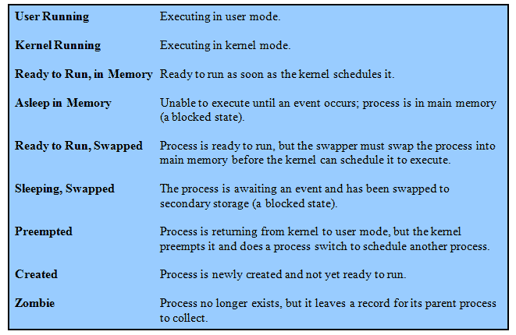
UNIX Process States
Notes:
A total of nine process states are recognized by the UNIX SVR4 operating system;
these are listed in Table 3.9

Slide 62
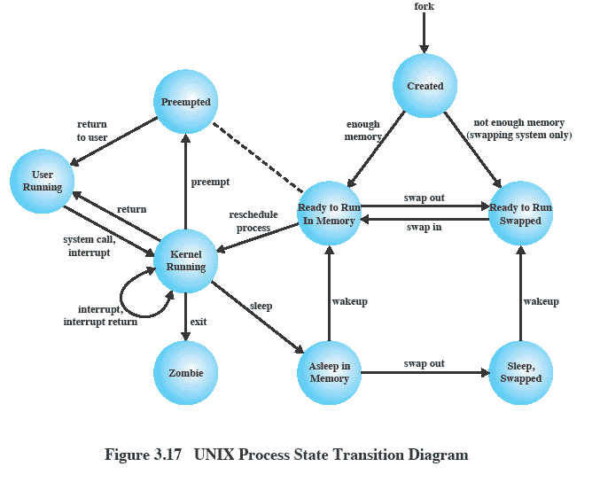
UNIX Process State Transition Diagram
Notes:
UNIX Process State Transition Diagram
This figure is similar to Figure 3.9b , with the two
UNIX sleeping states corresponding to the two blocked states. The differences are
as follows:
• UNIX employs two Running states to indicate whether the process is executing
in user mode or kernel mode.
• A distinction is made between the two states: (Ready to Run, in Memory) and
(Preempted). These are essentially the same state, as indicated by the dotted
line joining them. The distinction is made to emphasize the way in which the
preempted state is entered. When a process is running in kernel mode (as a
result of a supervisor call, clock interrupt, or I/O interrupt), there will come
a time when the kernel has completed its work and is ready to return control
to the user program. At this point, the kernel may decide to preempt the current
process in favor of one that is ready and of higher priority. In that case,
the current process moves to the preempted state. However, for purposes of
dispatching, those processes in the Preempted state and those in the (Ready to
Run, in Memory) state form one queue.
Preemption can only occur when a process is about to move from kernel mode
to user mode. While a process is running in kernel mode, it may not be preempted.
This makes UNIX unsuitable for real-time processing. Chapter 10 discusses the
requirements for real-time processing.
Two processes are unique in UNIX. Process 0 is a special process that is created
when the system boots; in effect, it is predefined as a data structure loaded
at boot time. It is the swapper process. In addition, process 0 spawns process 1,
referred to as the init process; all other processes in the system have process 1 as
an ancestor. When a new interactive user logs on to the system, it is process 1 that
creates a user process for that user. Subsequently, the user process can create child
processes in a branching tree, so that any particular application can consist of a
number of related processes.

Slide 63
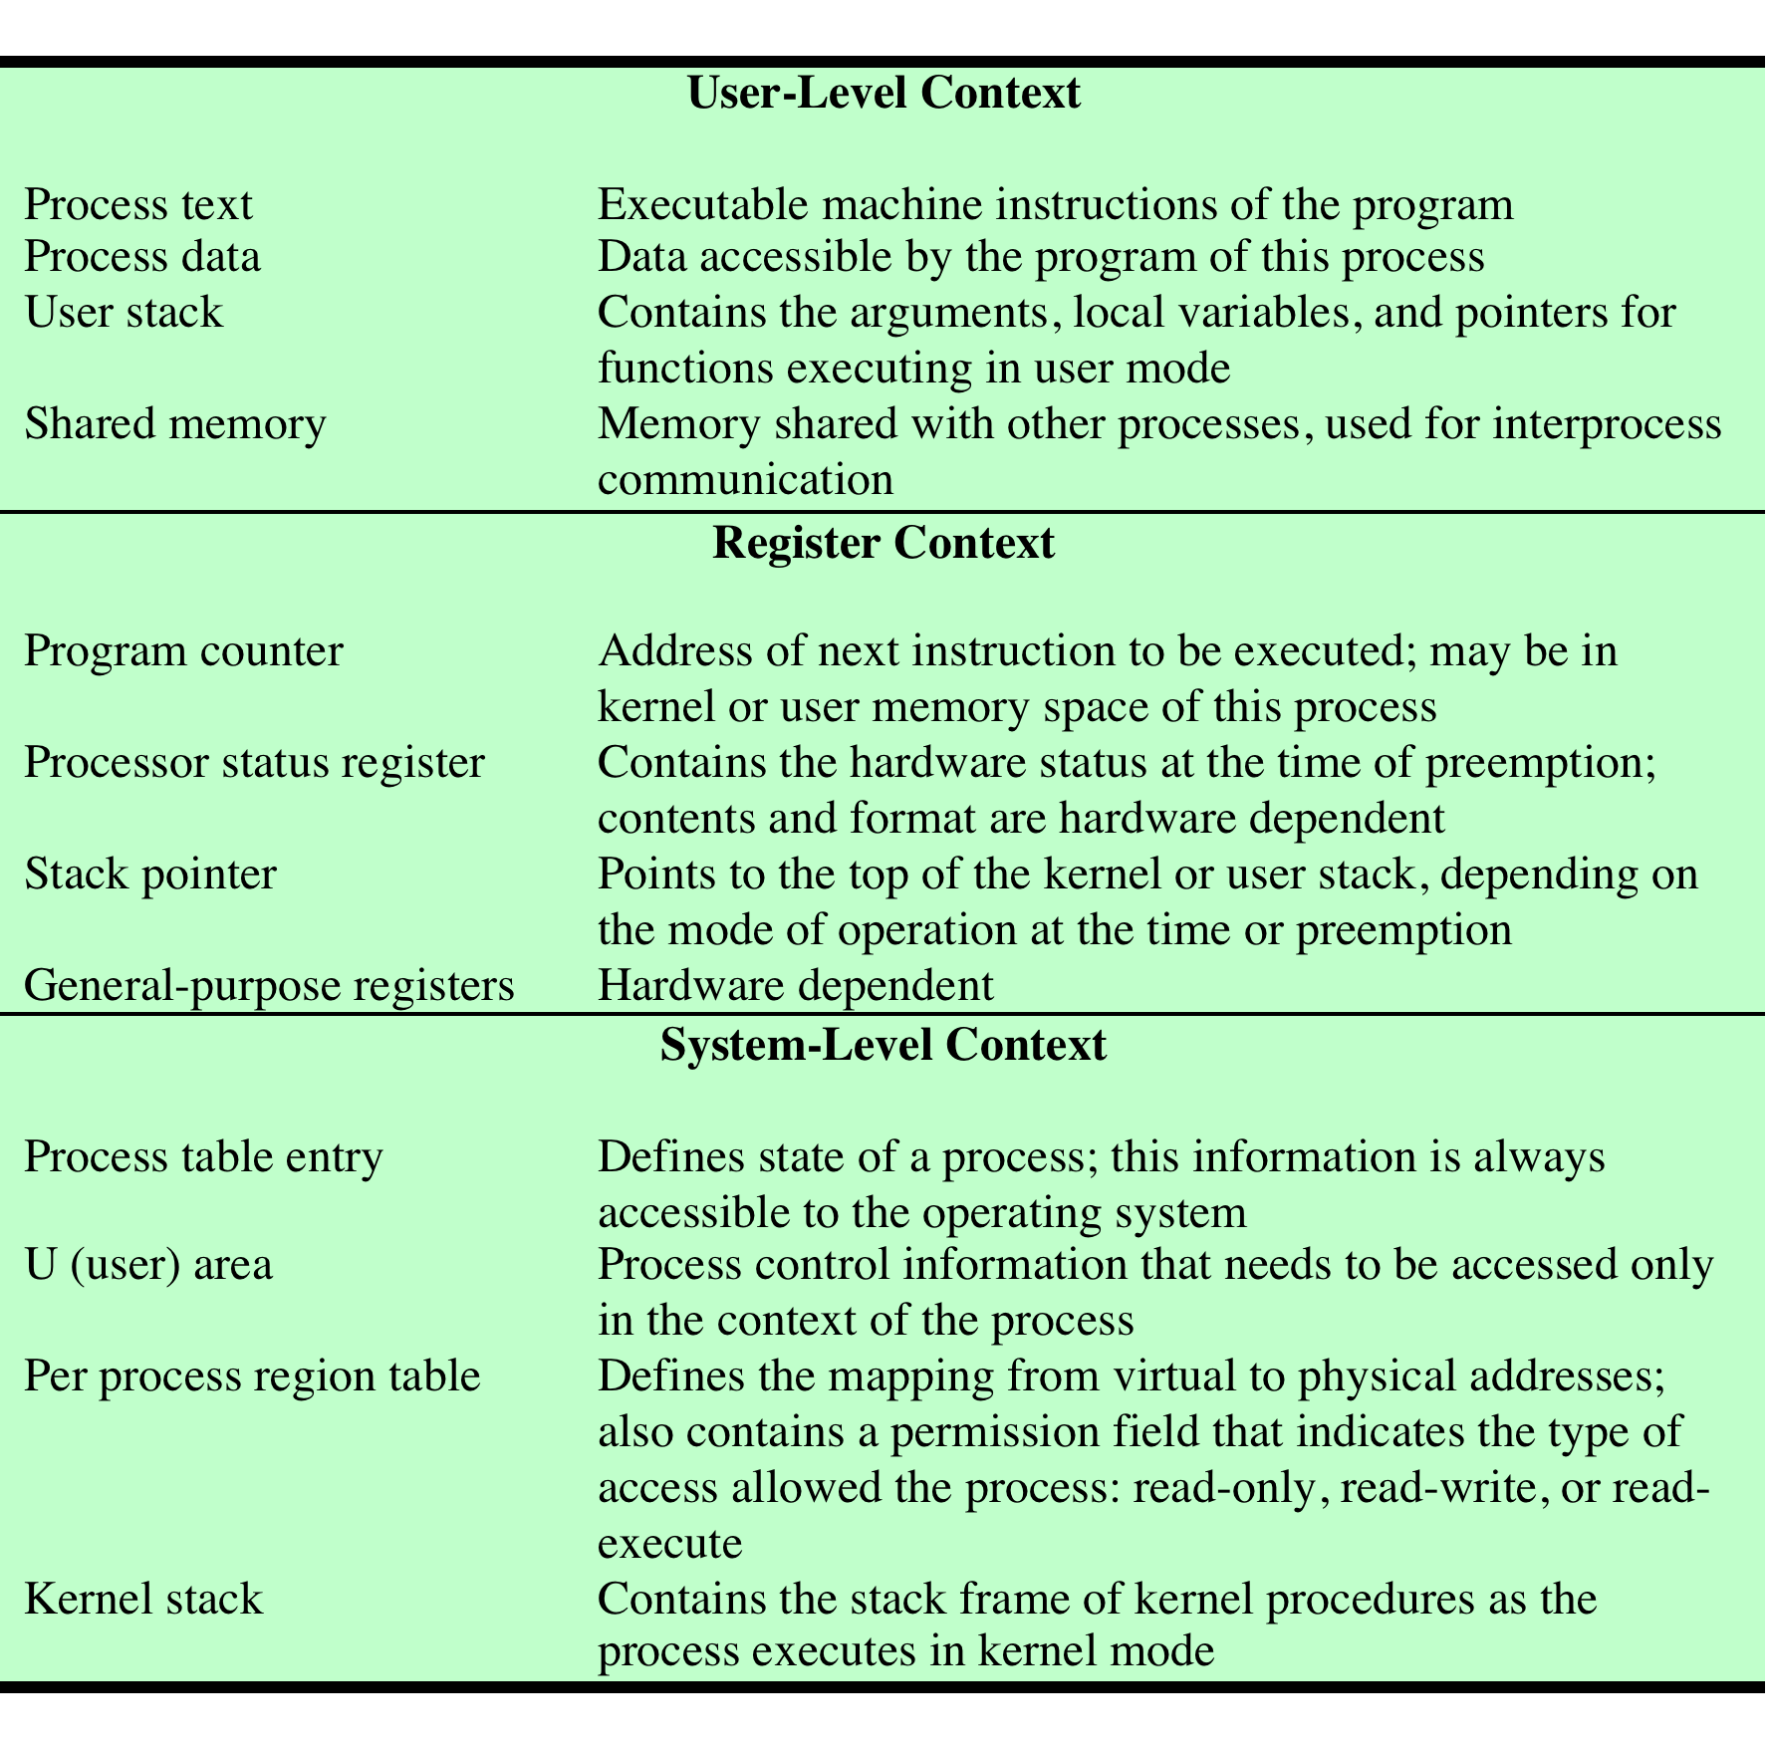
A Unix Process
Notes:
A process in UNIX is a rather complex set of data structures that provide the OS
with all of the information necessary to manage and dispatch processes. Table 3.10
summarizes the elements of the process image, which are organized into three parts:
user-level context, register context, and system-level context.
The user-level context contains the basic elements of a user’s program and
can be generated directly from a compiled object file. The user’s program is separated
into text and data areas; the text area is read-only and is intended to hold
the program’s instructions. While the process is executing, the processor uses the
user stack area for procedure calls and returns and parameter passing. The shared
memory area is a data area that is shared with other processes. There is only one
physical copy of a shared memory area, but, by the use of virtual memory, it appears
to each sharing process that the shared memory region is in its address space. When
a process is not running, the processor status information is stored in the register
context area.
The system-level context contains the remaining information that the OS
needs to manage the process. It consists of a static part, which is fixed in size and
stays with a process throughout its lifetime, and a dynamic part, which varies in
size through the life of the process. One element of the static part is the process
table entry. This is actually part of the process table maintained by the OS, with
one entry per process. The process table entry contains process control information
that is accessible to the kernel at all times; hence, in a virtual memory system, all
process table entries are maintained in main memory. Table 3.11 lists the contents
of a process table entry. The user area, or U area, contains additional process control
information that is needed by the kernel when it is executing in the context of
this process; it is also used when paging processes to and from memory. Table 3.12
shows the contents of this table.
The distinction between the process table entry and the U area reflects the
fact that the UNIX kernel always executes in the context of some process. Much
of the time, the kernel will be dealing with the concerns of that process. However,
some of the time, such as when the kernel is performing a scheduling algorithm
preparatory to dispatching another process, it will need access to information about
other processes. The information in a process table can be accessed when the given
process is not the current one.
The third static portion of the system-level context is the per process region
table, which is used by the memory management system. Finally, the kernel stack is
the dynamic portion of the system-level context. This stack is used when the process
is executing in kernel mode and contains the information that must be saved and
restored as procedure calls and interrupts occur.

Slide 64
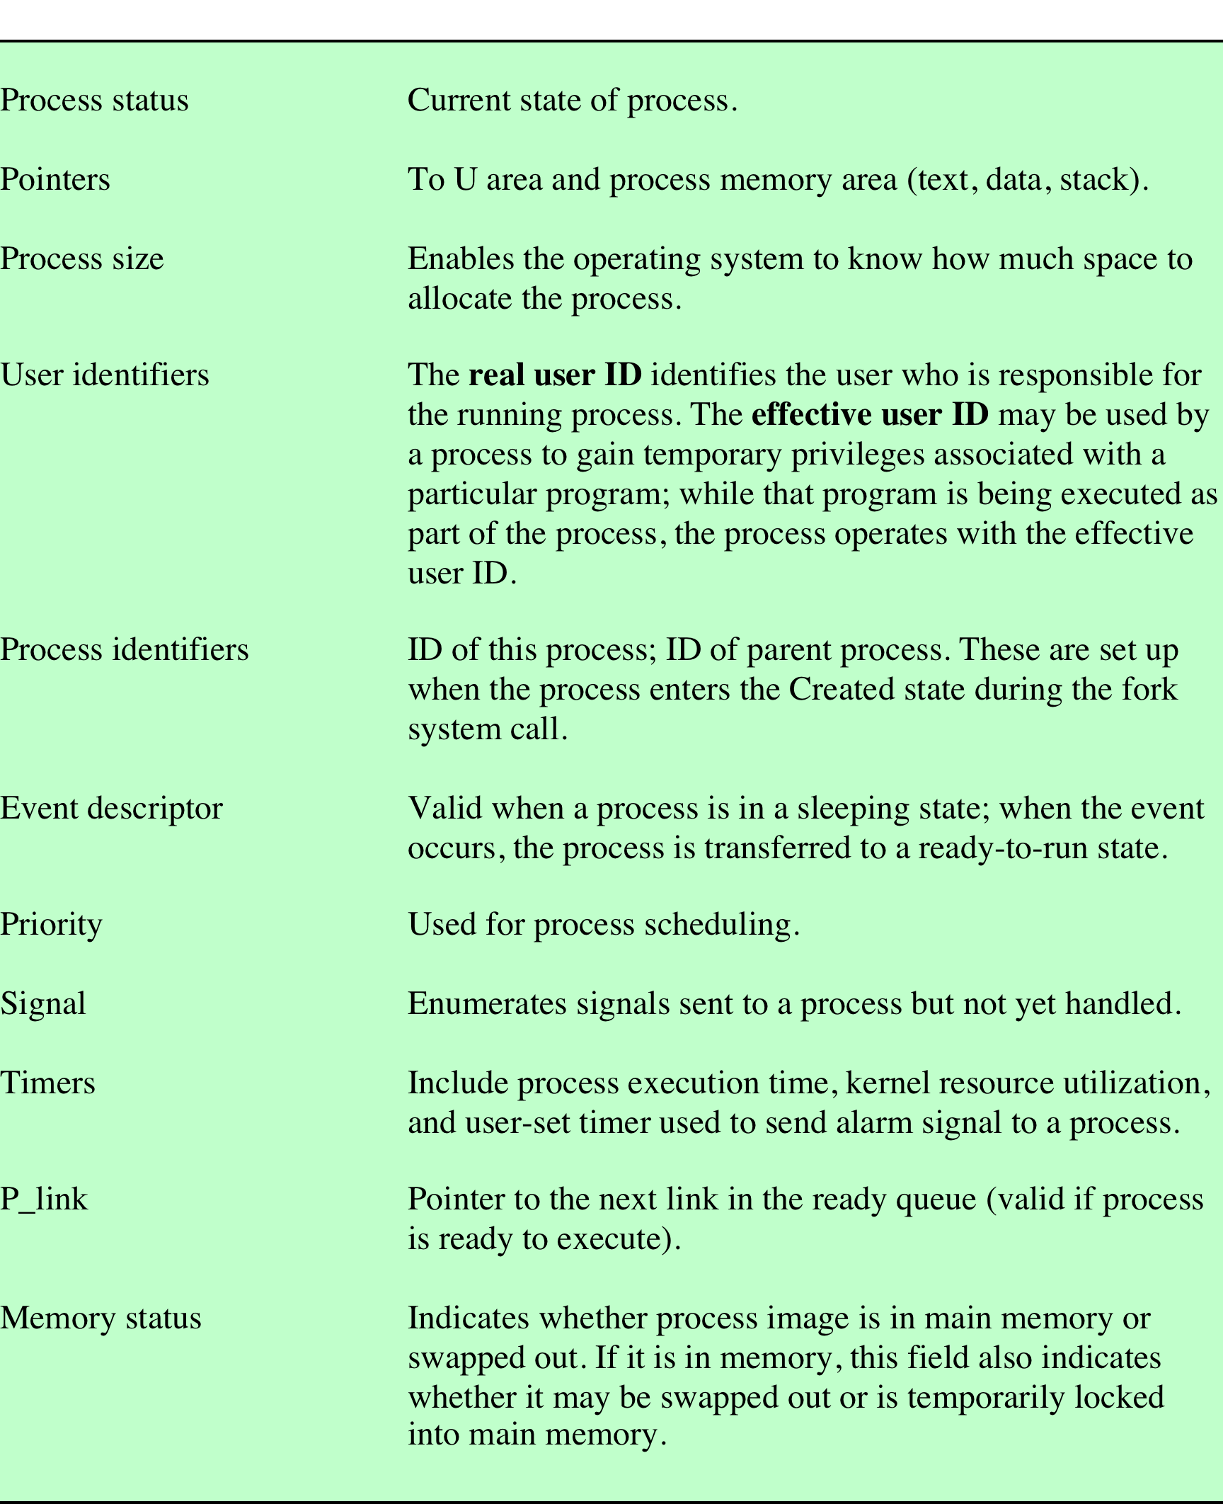
Table 3.11 UNIX Process Table Entry
Notes:
Table 3.11 lists the contents
of a process table entry. The user area, or U area, contains additional process control
information that is needed by the kernel when it is executing in the context of
this process; it is also used when paging processes to and from memory.

Slide 65
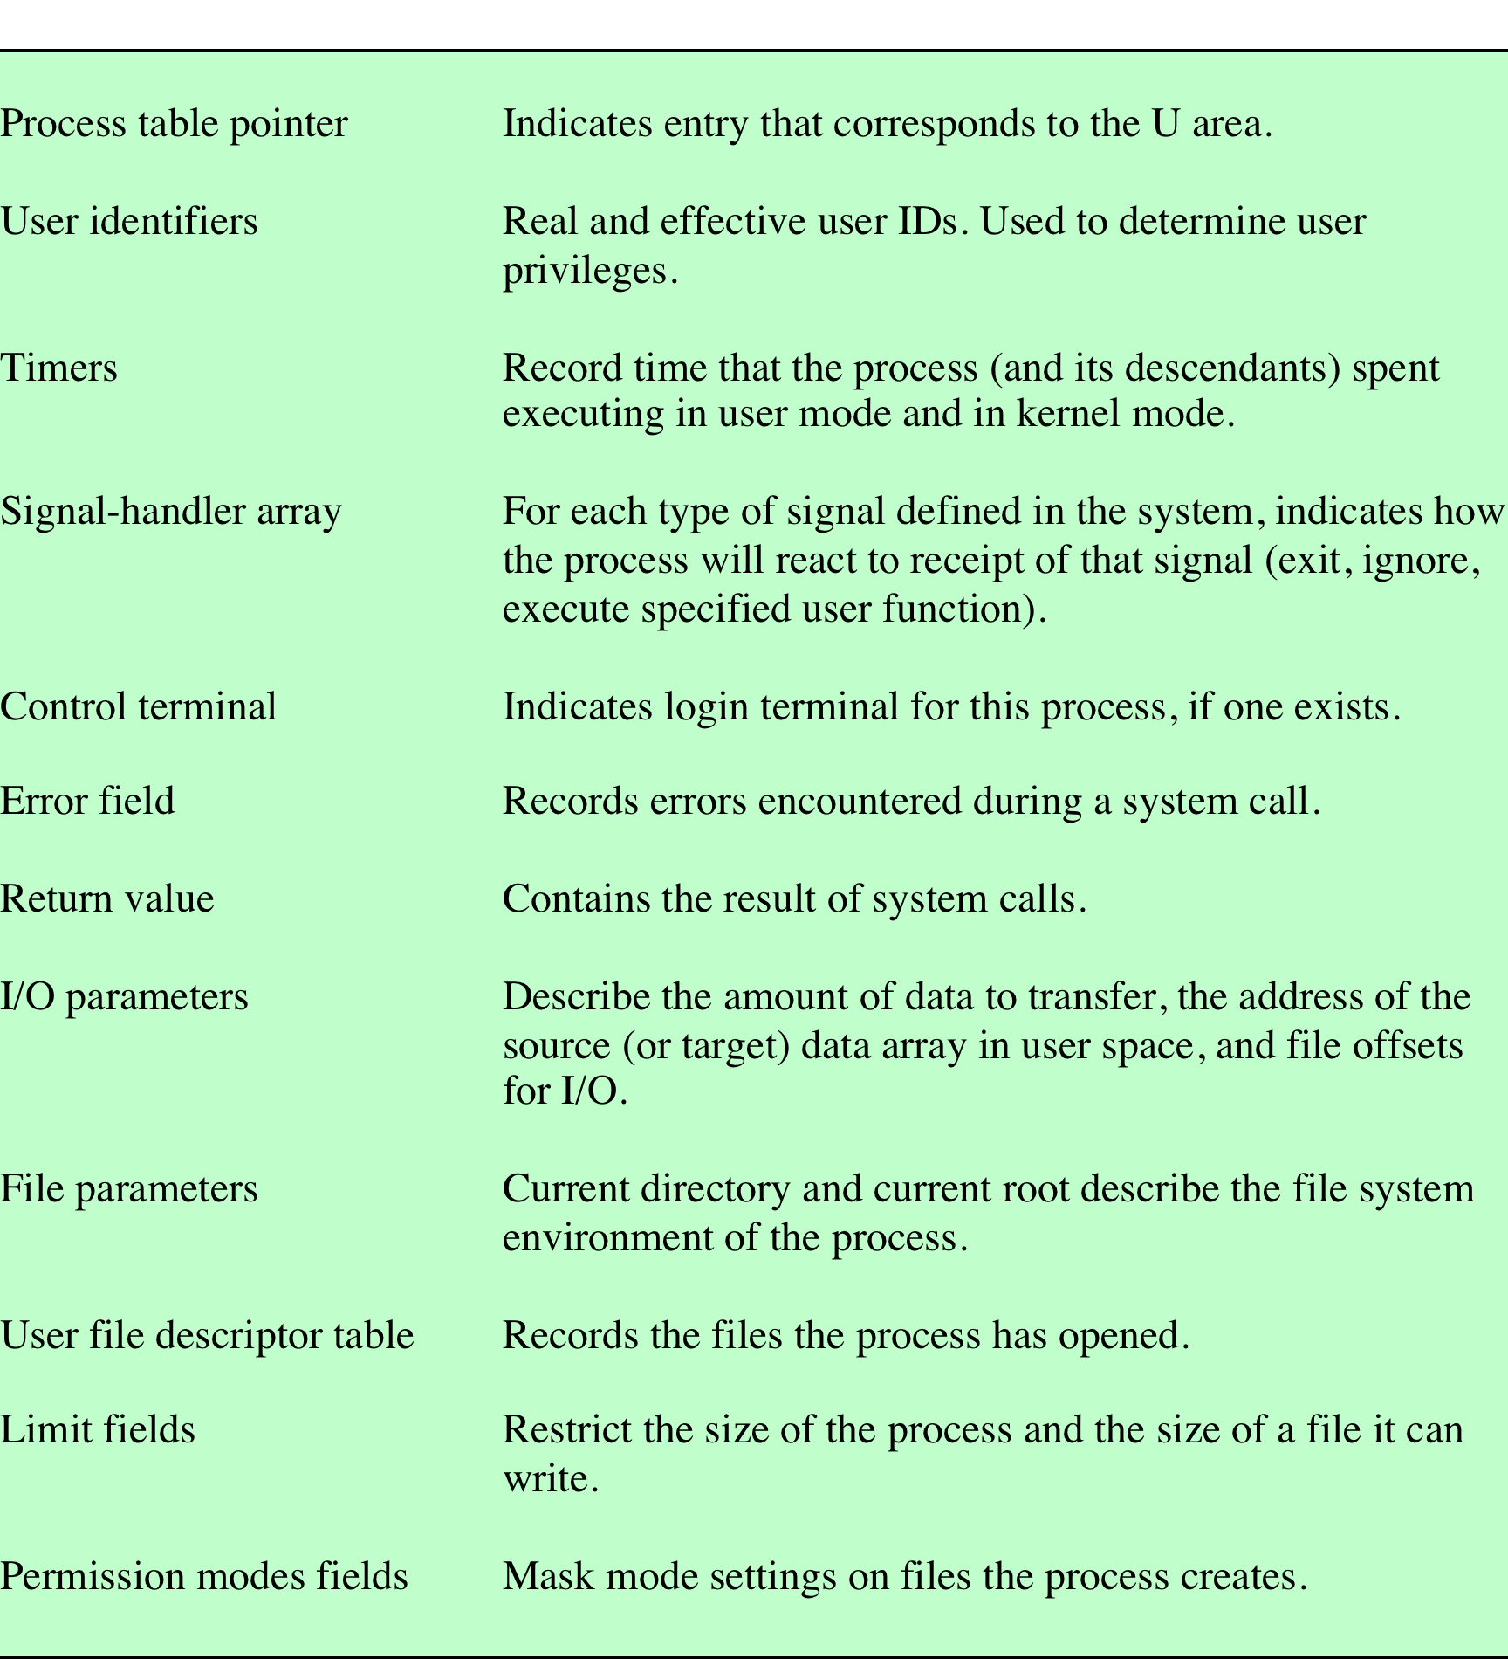
Table 3.12 UNIX U Area
Notes:
The user area, or U area, contains additional process control
information that is needed by the kernel when it is executing in the context of
this process; it is also used when paging processes to and from memory. Table 3.12
shows the contents of this table.

Slide 66
Process Creation
Process creation is by means of the kernel system call, fork( )
This causes the OS, in Kernel Mode, to:
1
Allocate a slot in the process table for the new process
2
Assign a unique process ID to the child process
3
Make a copy of the process image of the parent, with the exception of any shared memory
4
5
6
Increments counters for any files owned by the parent, to reflect that an additional process now also owns those files
Assigns the child process to the Ready to Run state
Returns the ID number of the child to the parent process, and a 0 value to the child process
Notes:
Process creation in UNIX is made by means of the kernel system call, fork( ). When
a process issues a fork request, the OS performs the following functions [BACH86]:
1. It allocates a slot in the process table for the new process.
2. It assigns a unique process ID to the child process.
3. It makes a copy of the process image of the parent, with the exception of any
shared memory.
4. It increments counters for any files owned by the parent, to reflect that an
additional process now also owns those files.
5. It assigns the child process to the Ready to Run state.
6. It returns the ID number of the child to the parent process, and a 0 value to
the child process.

Slide 67
After Creation
After creating the process the Kernel can do one of the following, as part of the dispatcher routine:
stay in the parent process
transfer control to the child process
transfer control to another process
Notes:
When the kernel has completed these functions it can do one of the following, as part of
the dispatcher routine:
• Stay in the parent process. Control returns to user mode at the point of the fork call of the parent.
• Transfer control to the child process. The child process begins executing at the same point in the code as the parent, namely at the return from the fork call.
• Transfer control to another process. Both parent and child are left in the Ready to Run state.

Slide 68
Summary
The most fundamental concept in a modern OS is the process
The principal function of the OS is to create, manage, and terminate processes
Process control block contains all of the information that is required for the OS to manage the process, including its current state, resources allocated to it, priority, and other relevant data
The most important states are Ready, Running and Blocked
The running process is the one that is currently being executed by the processor
A blocked process is waiting for the completion of some event
A running process is interrupted either by an interrupt or by executing a supervisor call to the OS
Notes:
Summary of Chapter 3

